Slide 1



LING 194 Week 6 Preparations (2): Presentation graphics
Ryan Ka Yau Lai
University of California, Santa Barbara

Slide 2
You made it so far!
So far, we’ve learnt to create different plots
Now let’s focus on making those graphs a pleasure to read!

Slide 3





ggplot themes

Slide 4
What do themes control?
Everything that’s not related to the interpretation of a graph
But to its physical appearance

Slide 5
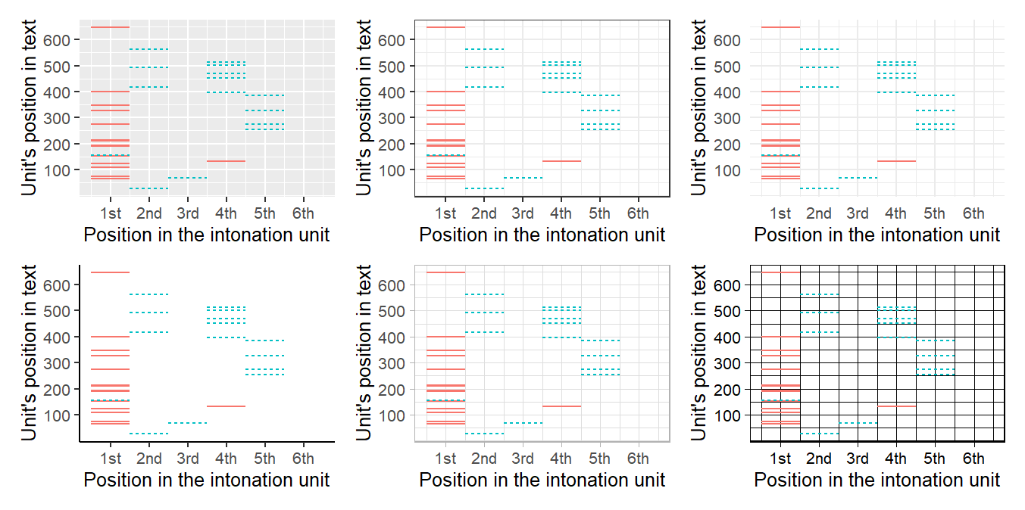
Default themes

Slide 6
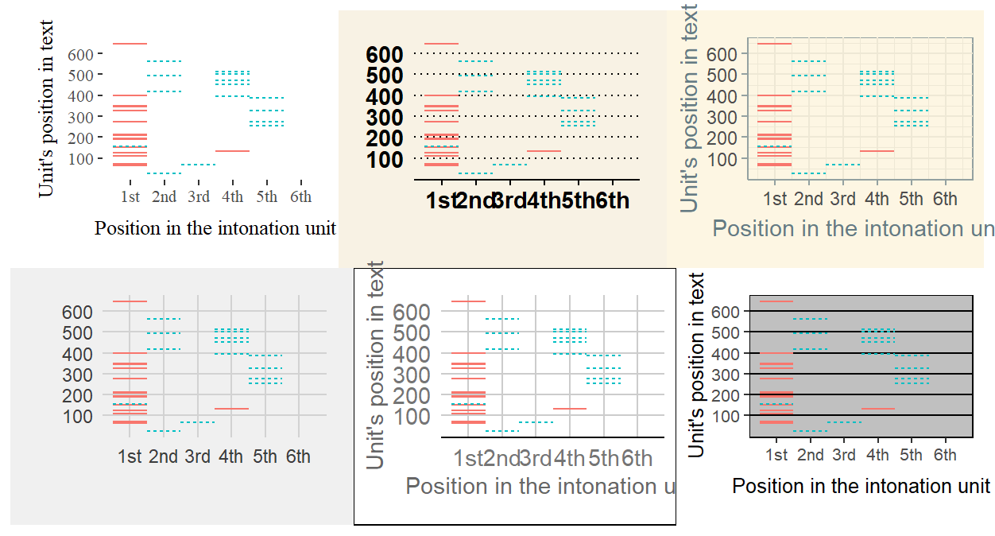
Other themes

Slide 7
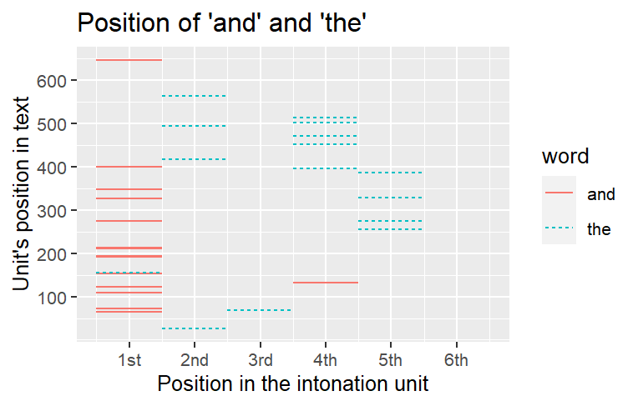
Setting text style
axis.text.y
axis.title.y
title
legend.title
Element | Setting
title axis.text.x axis.title.x axis.text.y axis.title.y legend.text legend.title … | family colour size angle hjust vjust …
legend.text
move them around
axis.title.x
axis.text.x
Syntax: theme(element = element_text(setting = value)

Slide 8
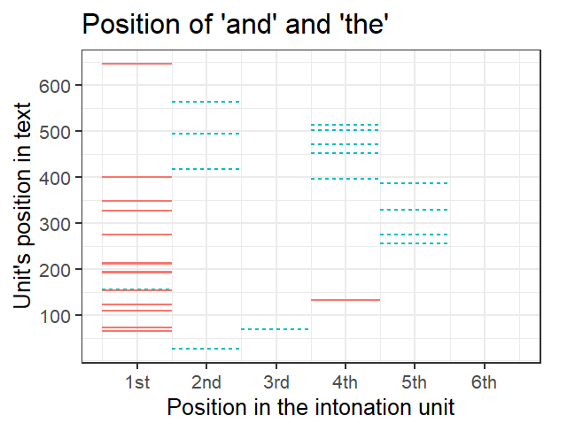
Setting line style
axis.line.y
axis.ticks.y
panel.grid.minor
Element | Setting
axis.line.x axis.ticks.x axis.line.y axis.ticks.y panel.grid.major panel.grid.minor … | colour linewidth arrow …
axis.ticks.x
axis.line.x
panel.grid.major
Syntax: theme(element = element_line(setting = value)

Slide 9
Hiding things
To hide the legend: theme(legend.position = “none”)
To hide a specific line or text: theme(element.name = element_blank())

Slide 10

Text annotations

Slide 11
Telling a story with data
When using graphs, we need to help people understand it
Hand-hold as much as you can!
We can highlight parts of the graph to do so

Slide 12
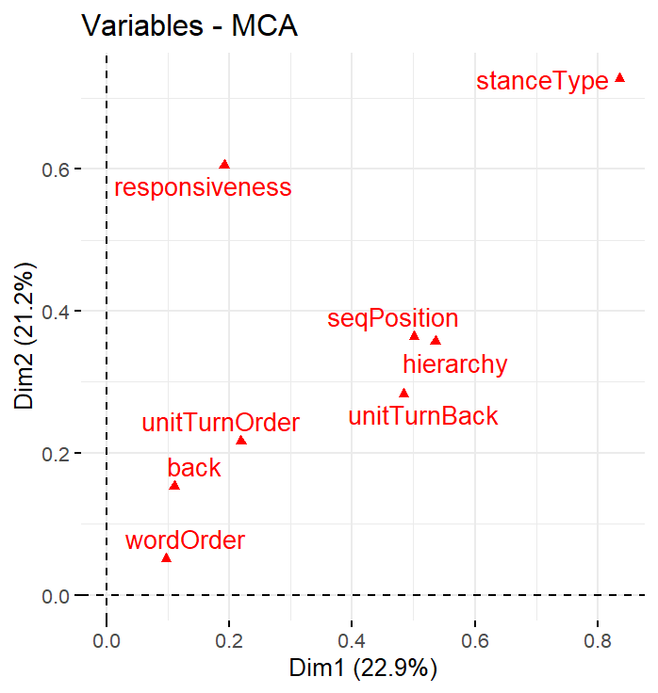
Geoms for adding text annotations
Usually: geom_text() or geom_label()
In ggmosaic: geom_text_mosaic()
With ggrepel: geom_text_repel() or geom_label_repel()
With ggfittext (fit text within boxes): geom_bar_text()
Aesthetic properties: x, y, label, colour, size, family
ggrepel helps avoid text labels from overlapping

Slide 13
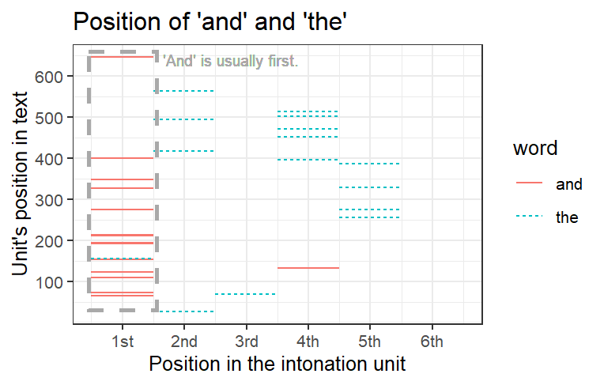
Geoms for highlighting parts of the graph
geom_rect() can bring attention to rectangular parts of the graph
geom_polygon() is similar, but can allow you to use any polygonal shape

Slide 14
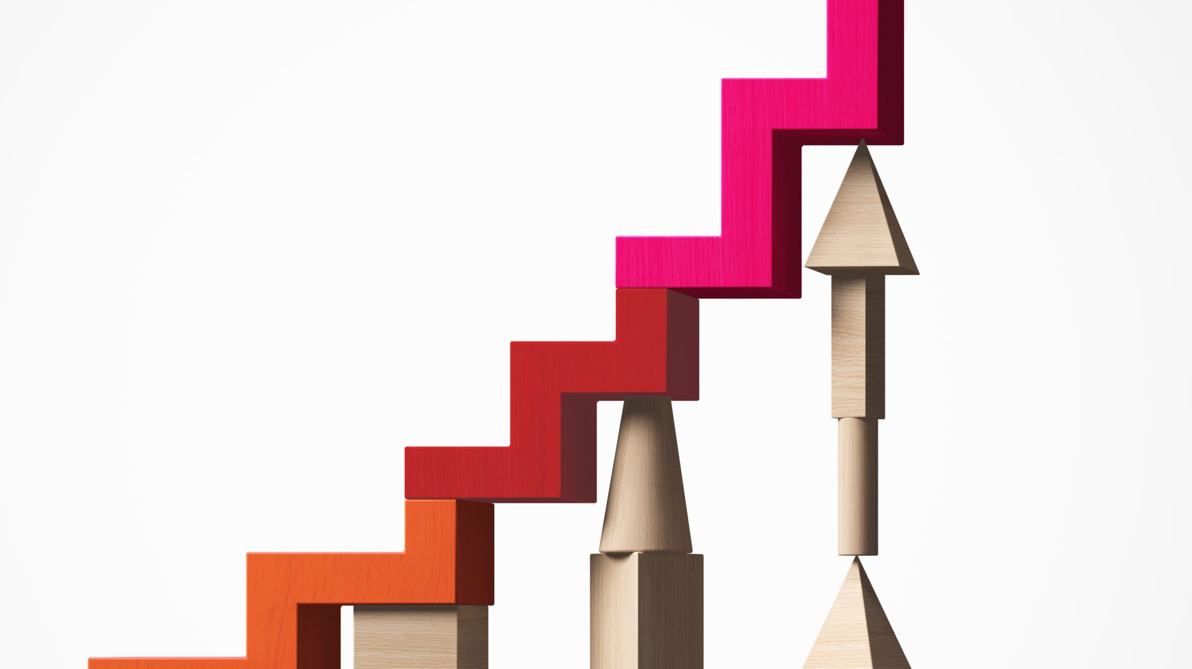
Relationships between graphs

Slide 15
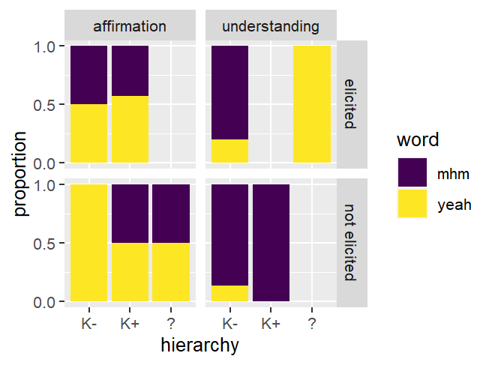
facet_grid()
Similar to facet_wrap
Used when you want rows and columns to represent two different variables

Slide 16
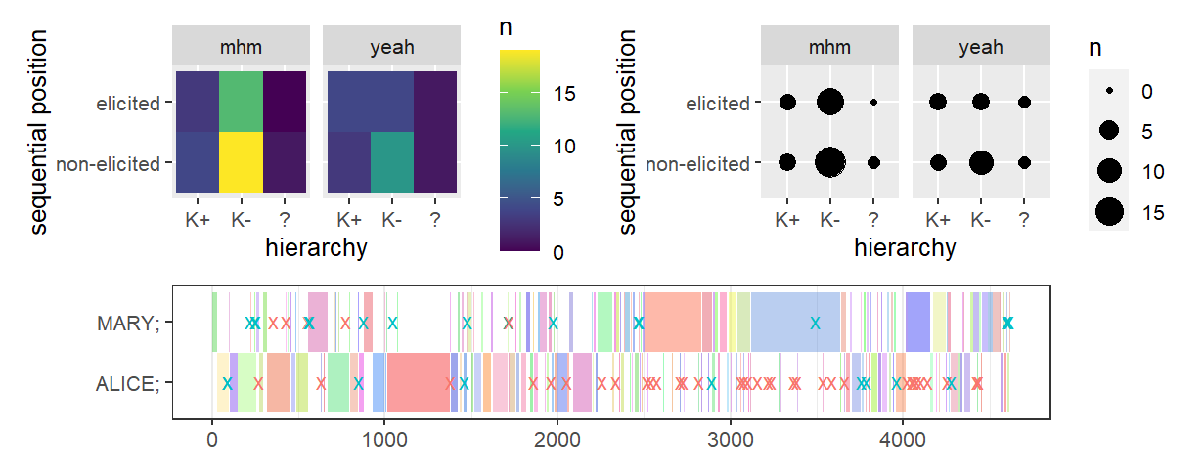
Patchwork
Allows you to combine different graphs
Use + to put graphs side by side, / to put them on top of each other

Slide 17

SVG export

Slide 18
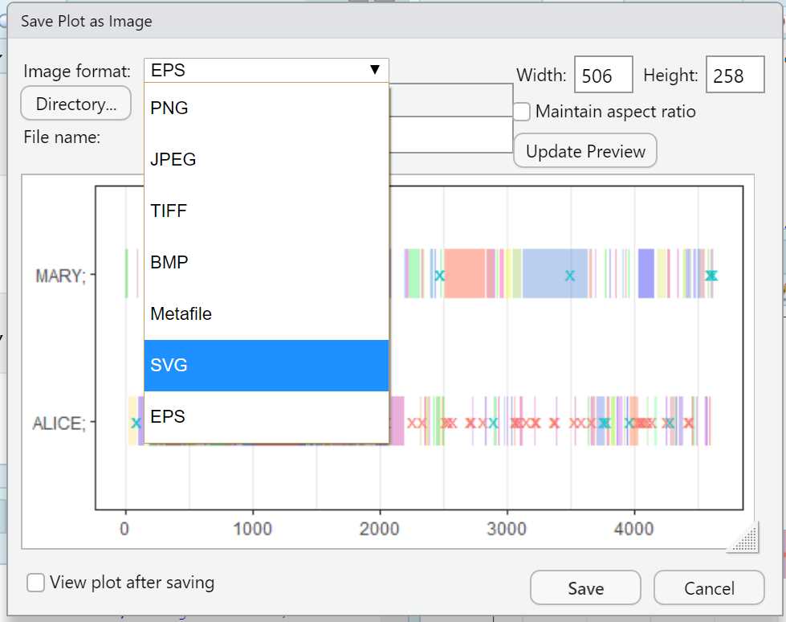
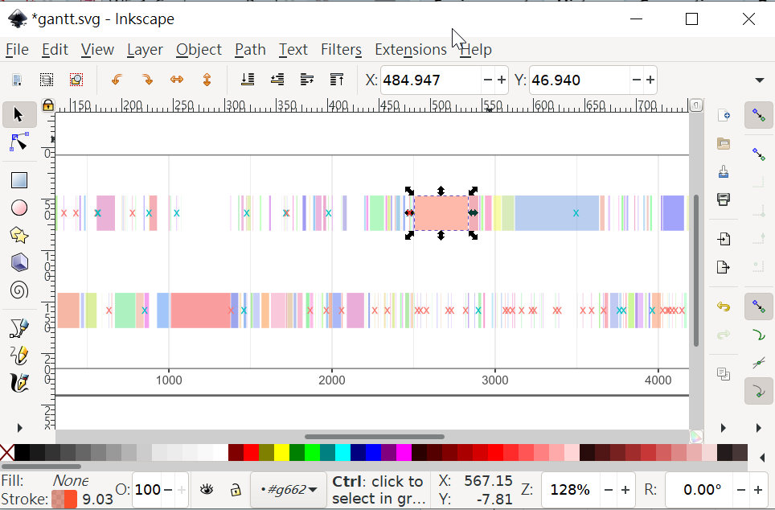
Saving and editing as SVG

Slide 19
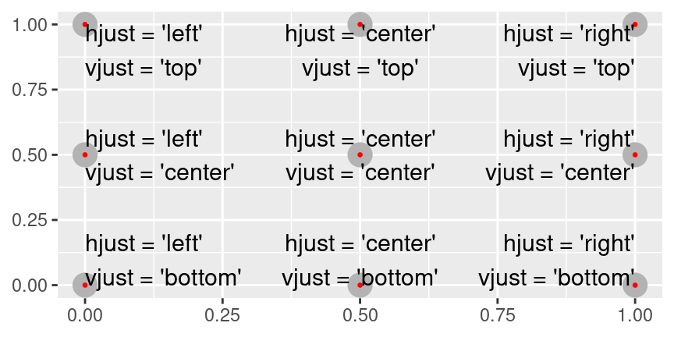
hjust and vjust with words

Slide 20

Using data to tell a story

Slide 21
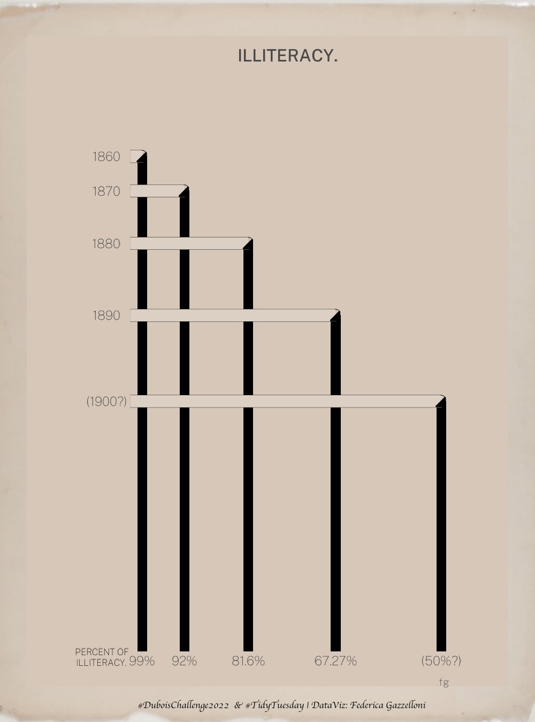
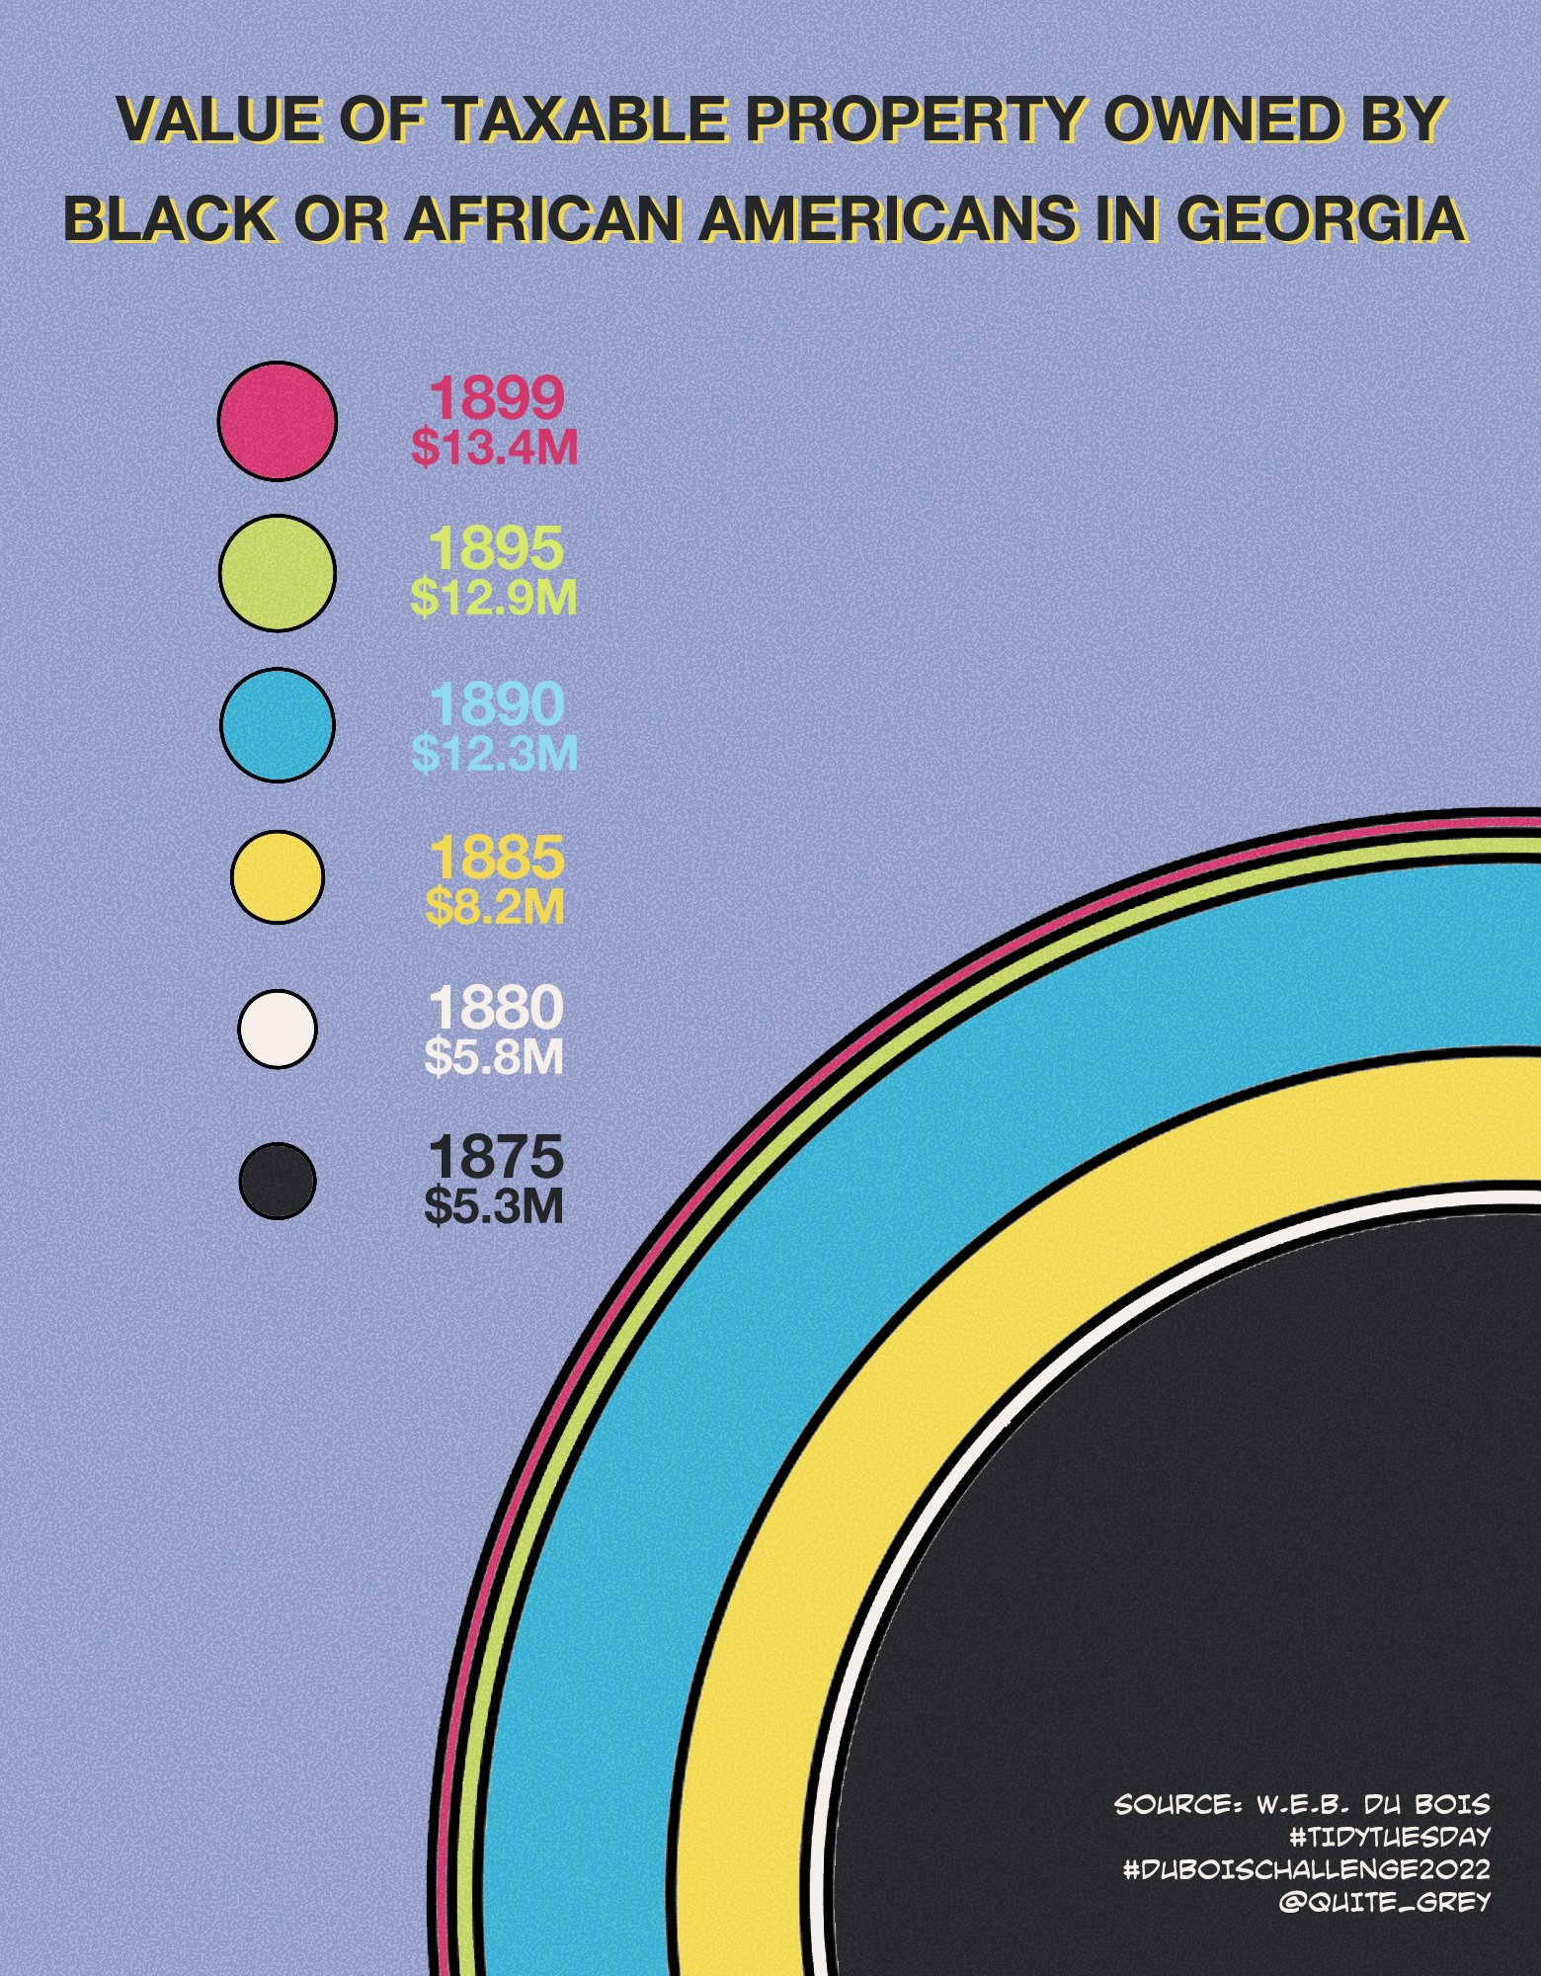
What story was WEB Du Bois trying to tell?
Ggplot versions
of the original ones
by
@fgazzelloni
@quite_grey

Slide 22
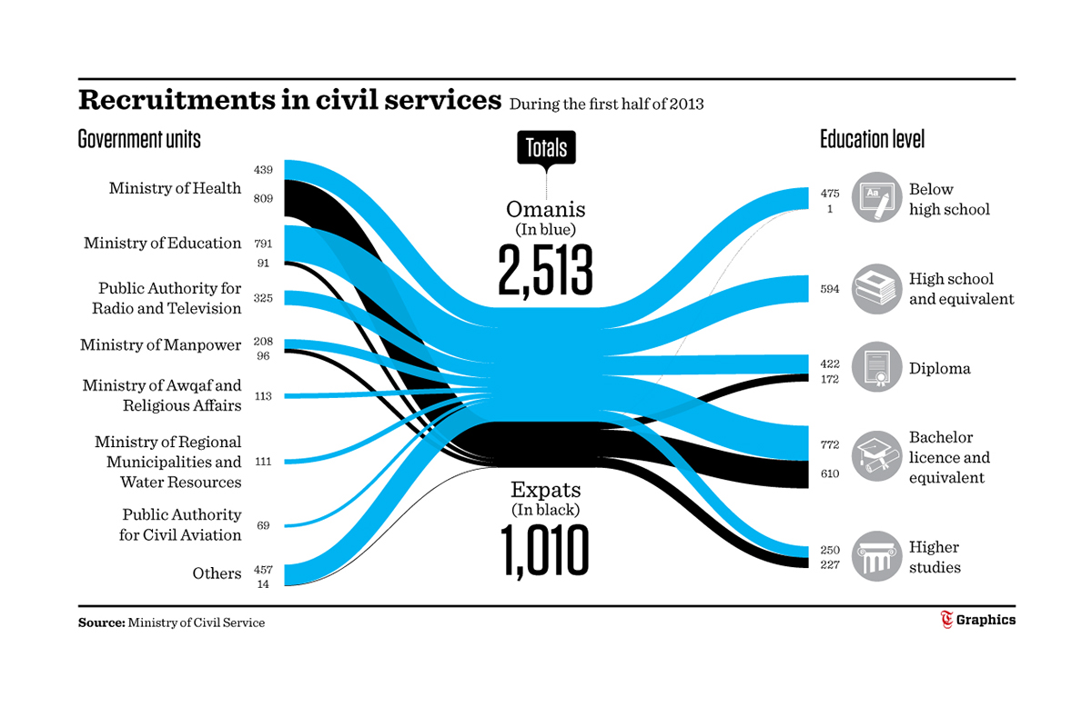
What story do you see here?
How is the story aided by the text?

Slide 23
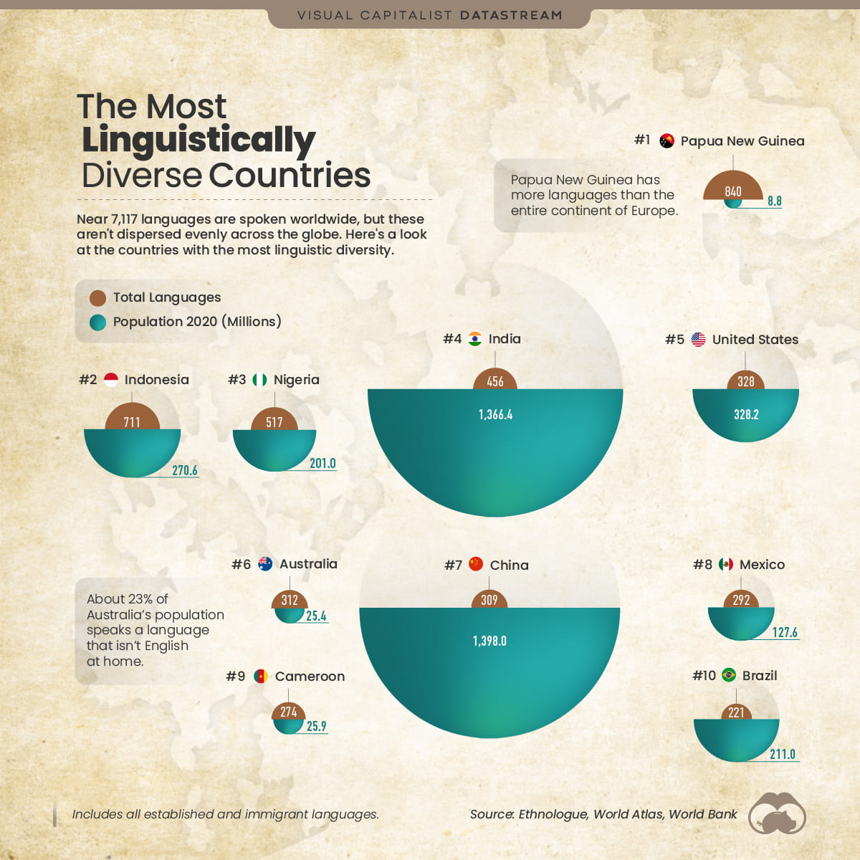

Slide 24
Good luck! ☺

