Slide 1
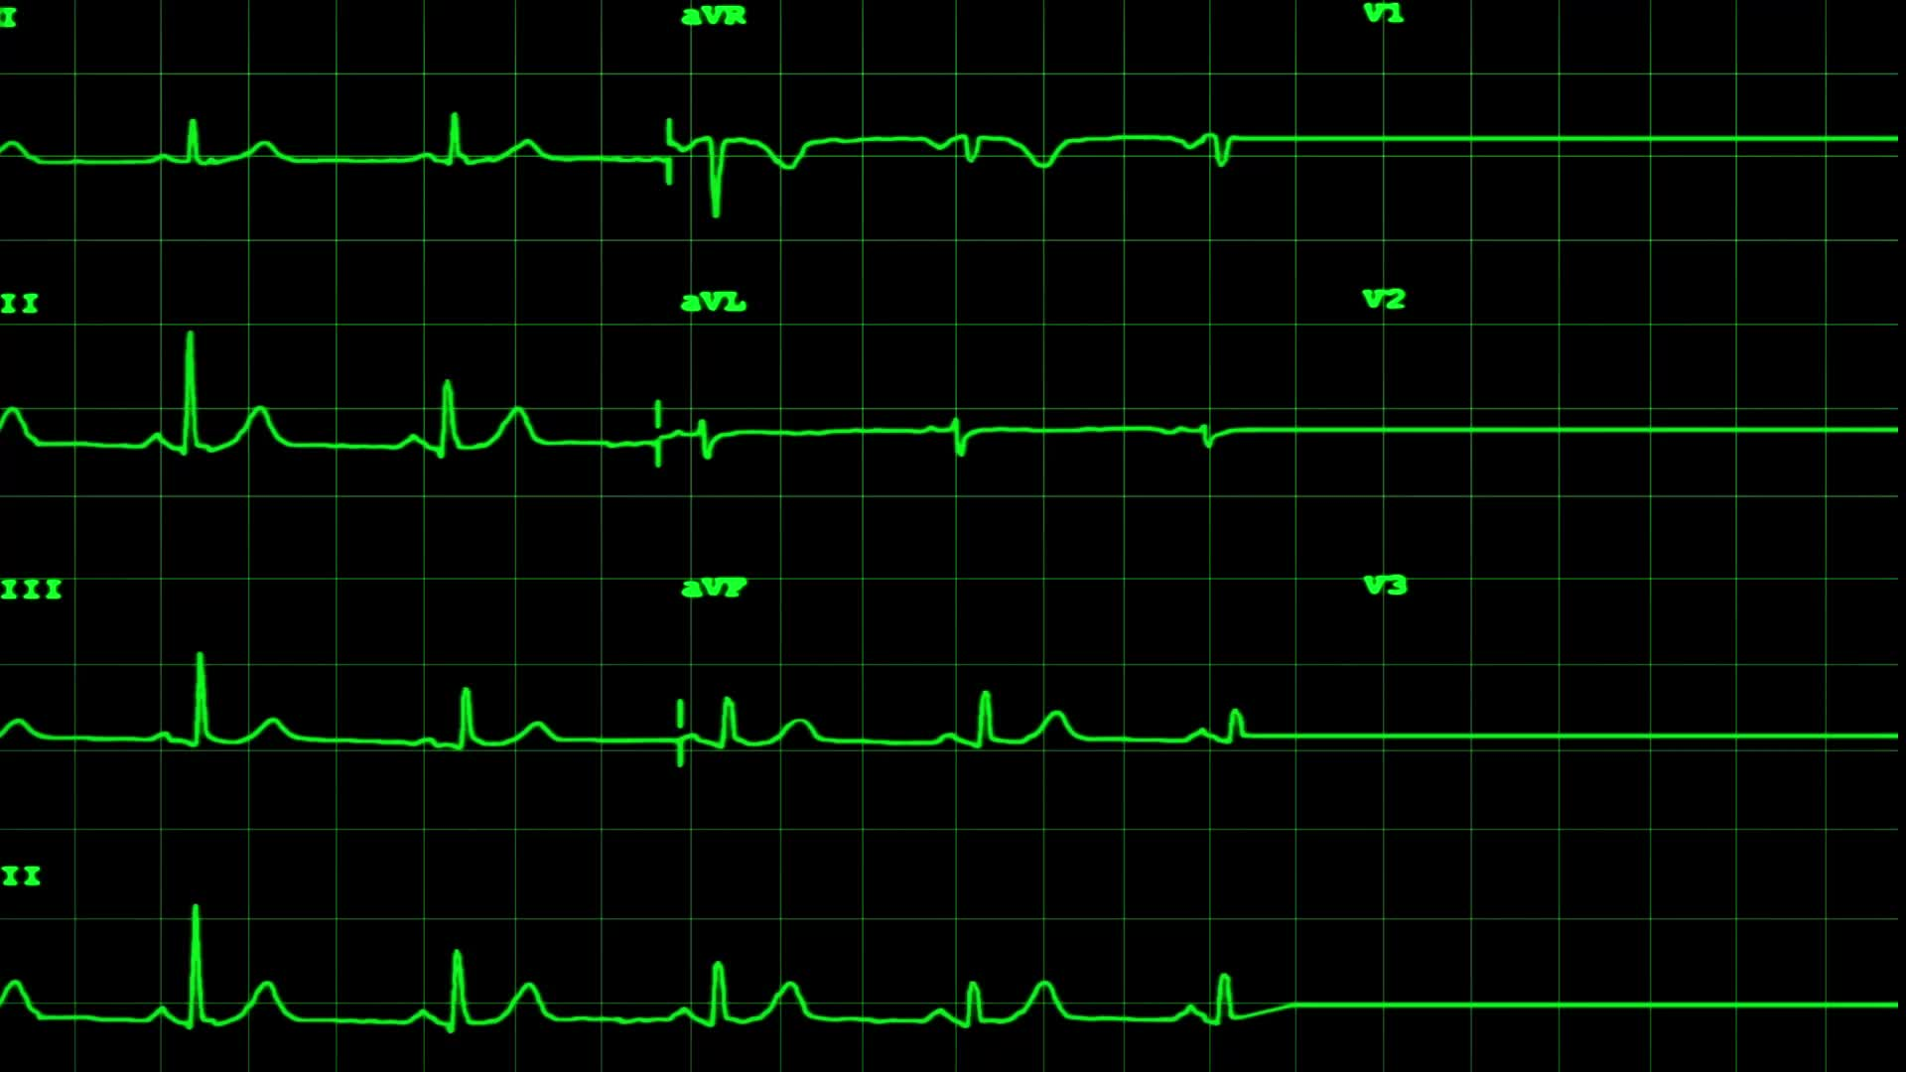

LING 194 Week 3 Preparations (2): Resonance
Ryan Ka Yau Lai
University of California, Santa Barbara

Slide 2

Dialogic resonance
Simply put: Selective reproduction of linguistic signs from previous discourse context
  Words, grammatical constructions …
Psycholinguistic perspective (in the mind): Priming
Discourse perspective (in language use): Resonance

Slide 3
Resonance cycle
Priming
Reproduction
Resonance
Hearing a structure once activates that structure in your mind.
When producing language, you reproduce that structure in your own production.
By producing a new utterance with a similar structure, you resonate with the previous utterance.

Slide 4
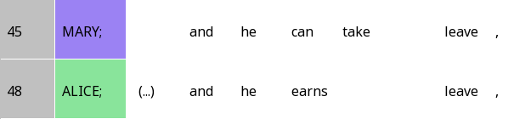

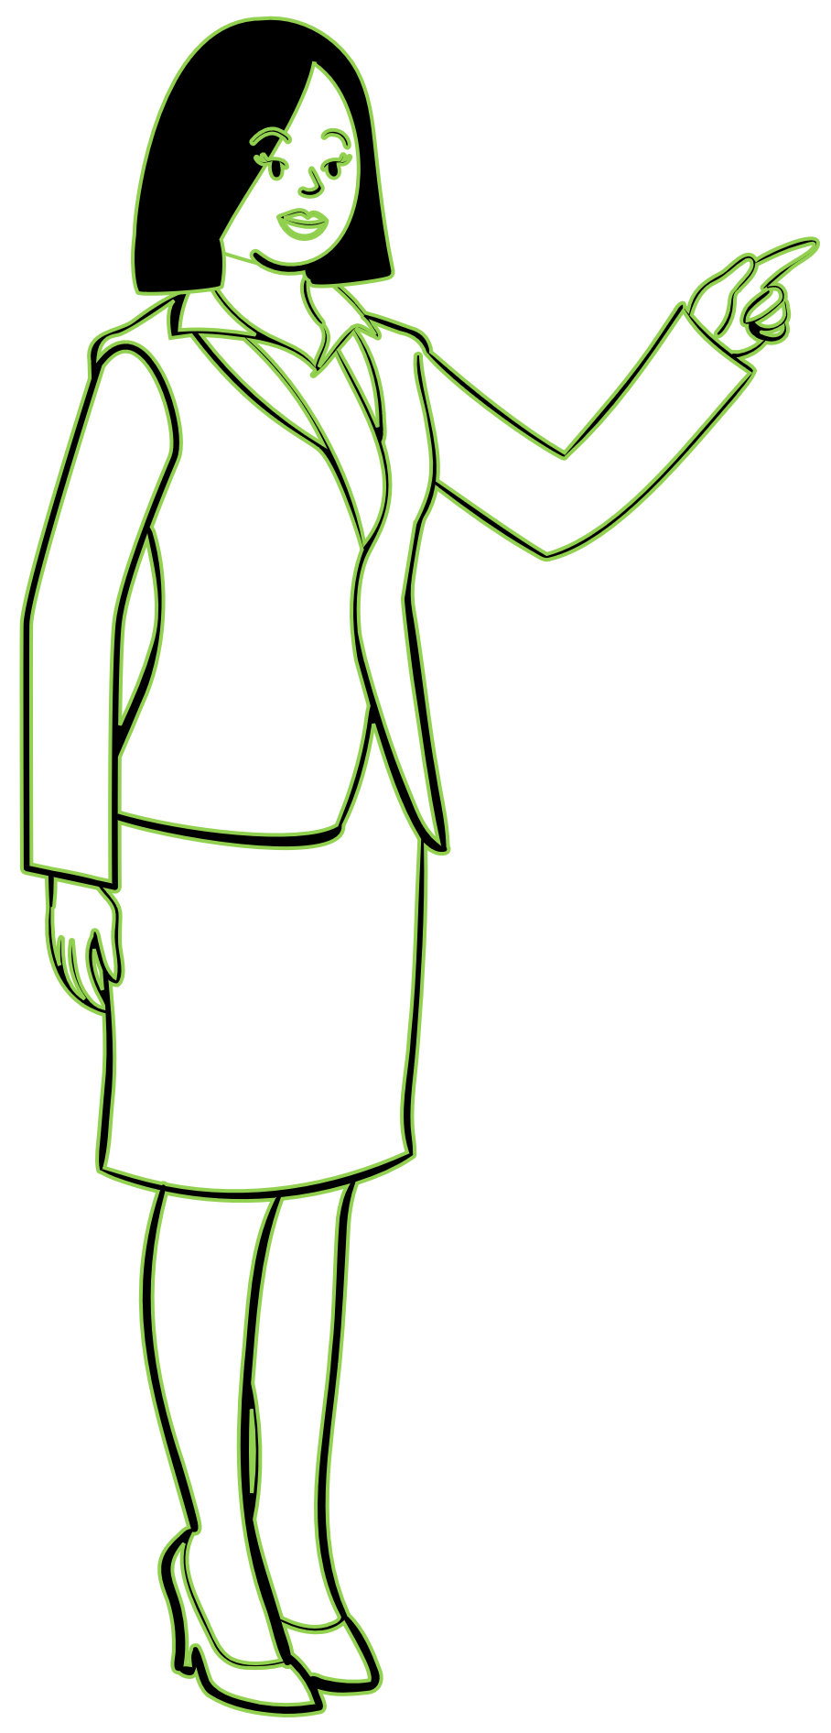
1. Priming
and he + verb + object

Slide 5
2. Reproduction

Slide 6
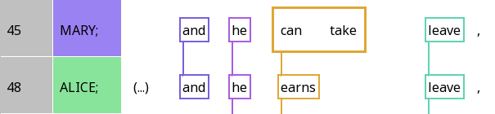
3. Resonance

Slide 7
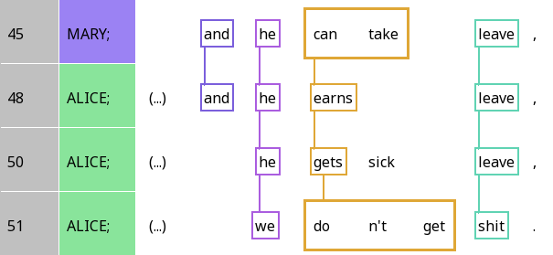
Frame resonance and focal resonance
Frame resonance: Resonance between identical elements or highly conventional correspondences

Slide 8
Frame resonance and focal resonance
Focal resonance: Resonance between elements that strongly contrast with the previous element, tell you ‘what’s new/different’

Slide 9
Frame resonance and focal resonance
Question: Which of the resonances between the third and fourth lines are frame resonances? Which are focal resonances? How does your answer differ from the relationships between the first three lines?

Slide 10
Frame resonance and focal resonance
Frame resonance
Focal resonance
Question: Which of the resonances between the third and fourth lines are frame resonances? Which are focal resonances? How does your answer differ from the relationships between the first three lines?

Slide 11
Diagraph
 | A | B | C | D | E
Mary | and | he | can take |  | leave
Alice | and | he | earns |  | leave
Alice |  | he | gets | sick | leave
Alice |  | we | don’t get |  | shit

Slide 12
Analysing analogies in focal resonance
 | B | C | E | C – interpretation
Mary | he | can take | leave | can – Possibility
Alice | he | earns | leave | -s – Habit
Alice | he | gets | leave | -s – Habit
Alice | we | don’t get | shit | don’t - Impossibility

Slide 13
Analysing analogies in focal resonance
 | B | C | E | E – interpretation
Mary | he | can take | leave | specific thing
Alice | he | earns | leave | specific thing
Alice | he | gets | leave | specific thing
Alice | we | don’t get | shit | anything

Slide 14
Things to look for in the paper
How do they operationalise degree of resonance?
What role does self-resonance (resonating with yourself) vs. other-resonance (resonating with someone else) play?

Slide 15

Notes on determining resonance

Slide 16
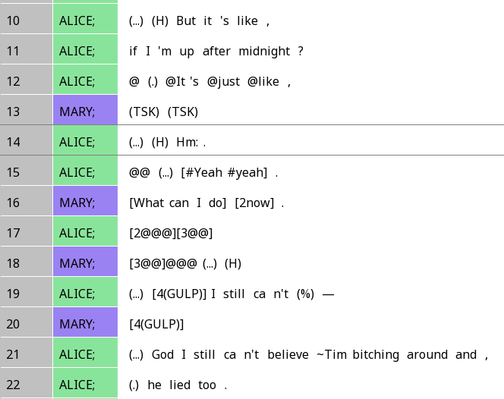
Resonance is about engagement
When you are unsure whether two elements resonate, ask yourself:
Is the speaker trying to engage with the preceding utterance by creating a correspondence?
It’s more complex than just taking grammar or meaning into account; we have to make an informed decision based on all of that!
Do you think these two lines resonate? Why?

Slide 17

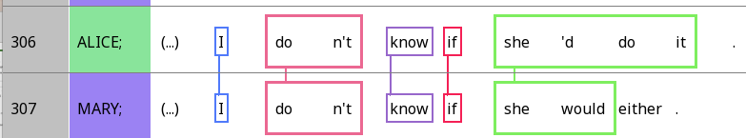
Resonance is about engagement
Whenever you want to determine whether two words appear in the same column, ask yourself:
Am I showing all the structural correspondences between the two?
Which one do you prefer?

Slide 18

Resonance and engagement

Slide 19
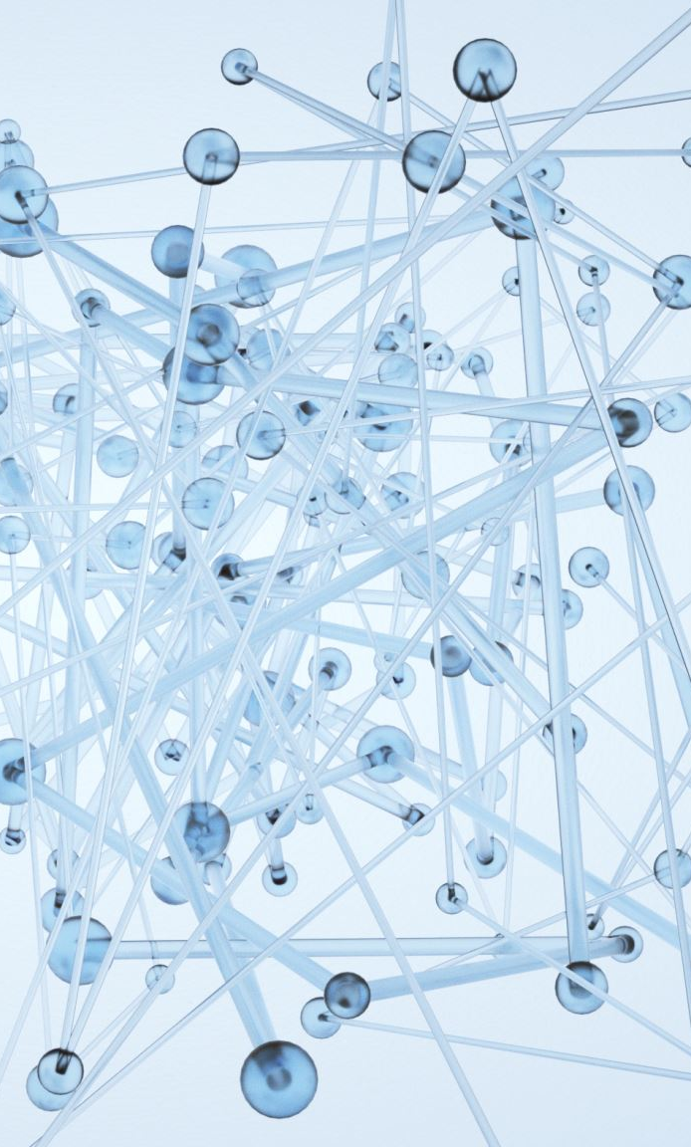
Resonance and responsiveness
Resonance shows the current utterance’s contingency on a previous utterance
When we resonate with someone, we are responsive to what they just said
Recall that resonance is the selective reproduction of structures and patterns
When we select some parts to reproduce, and other parts not to, we are also engaging with the prior discourse context!

Slide 20
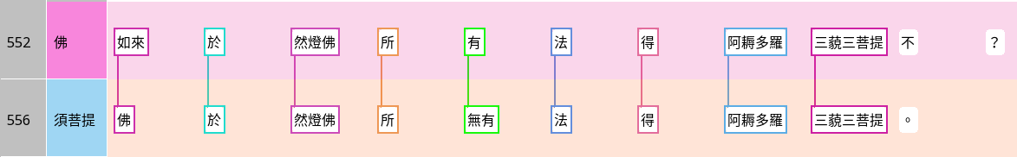
Resonance and adjacency pairs
Repetition-type answers, and often transformative answers, involve resonance
Did the Tathāgata acquire anuttara-samyak-saṃbodhi at the Dīpaṃkara’s place?
The Buddha did not acquire anuttara-samyak-saṃbodhi at the Dīpaṃkara’s place?
Buddha | Tathāgata | at | Dīpaṃkara | place | have | dharma | acquire | anuttara | samyak-saṃbodhi | no
Subhūti | Buddha | at | Dīpaṃkara | place | not.have | dharma | acquire | anuttara | samyak-saṃbodhi
Q: Where is the focal resonance?

Slide 21
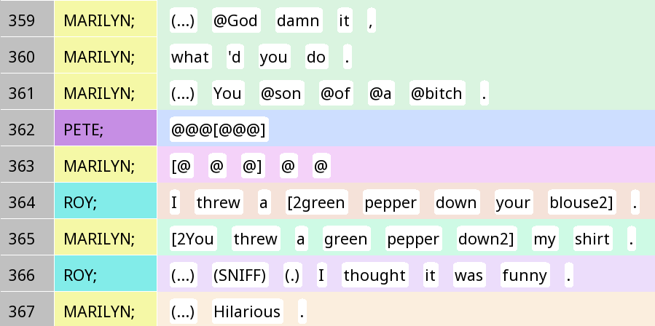
Resonance and interruptions

Slide 22
When we resonate with someone else …
What do we add?
What do we subtract?
What do we change?
What do we move around?

Slide 23
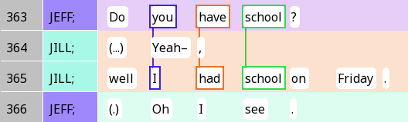
Adding stuff for clarity
Jill starts with an interjection-type answer, but cuts it off
Changes to a transformative answer: She had school on Friday (but not on a closer date)
‘On Friday’ is non-resonating (added)

Slide 24
Why do people subtract?
They want to express a different opinion (stance differential)
They’re leaving out stuff that’s obvious and inferable (ellipsis)
They’re leaving out conjunctions that no longer matter (next week)
… The possibilities are endless

Slide 25
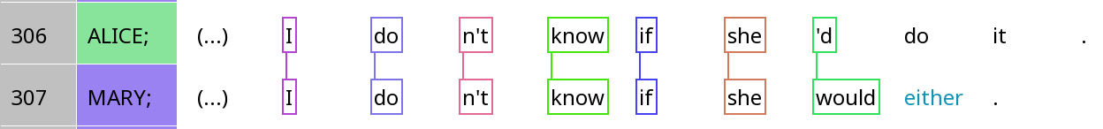
When silence is ellipsis
 | Stance subject | Position |  |  | Stance object |  |  |  |  | Alignment
Alice | I | do | n’t | know | if | she | ‘d | do | it
Mary | I | do | n’t | know | if | she | would | (do) | (it) | either
Question: Do you think ellipsis is more likely with frame resonance or focal resonance?

Slide 26
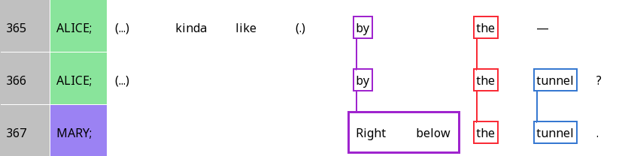
Resonance and epistemic authority
 | A | B | C-E |  |  | F
Alice | (Alice) | kinda like | by | the | tunnel | ? (seeking confirmation)
Mary | (Mary) | (higher authority) | right below | the | tunnel | . (reserved agreement)

Slide 27
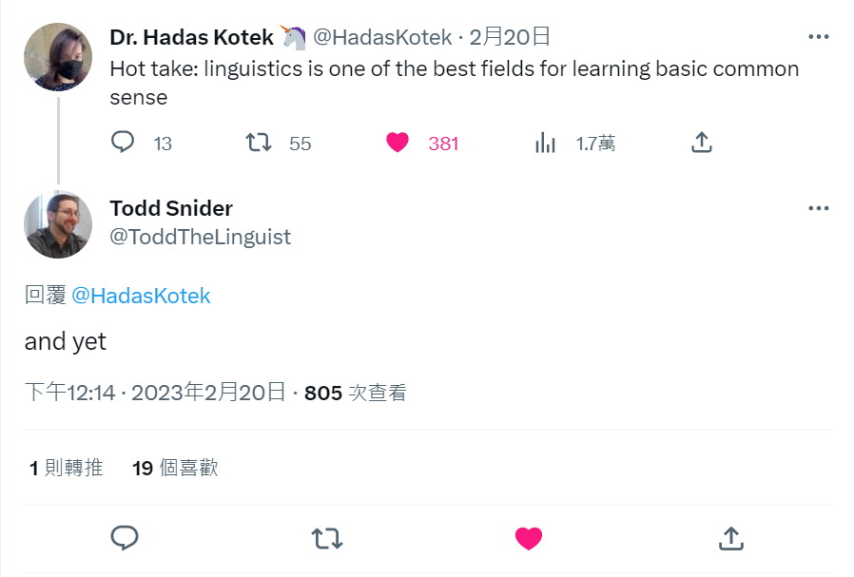
When it’s both …

Slide 28

Operationalising level of resonance

Slide 29
Pop quiz
How did Tantucci & Wang operationalise resonance?

Slide 30
Syntactic and ‘phonetic’ resonance
‘Phonetic’ resonance: Number of words in common between two Ius
Syntactic resonance: Number of columns in common
 | A | B | C | D | E
Mary | and | he | can take |  | leave
Alice | and | he | earns |  | leave
Alice |  | he | gets | sick | leave
Alice |  | we | don’t get |  | shit

Slide 31
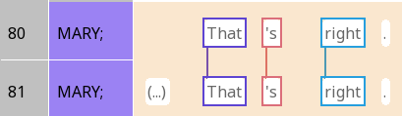
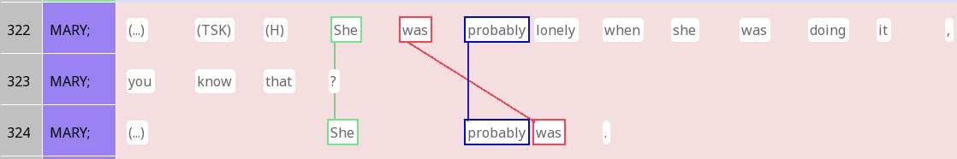
How good of an idea are these measures?
My main feeling about these measures: We also need normalised measures
Possible solution: Level of resonance between two lines = Number of columns divided by total number of tokens in the two lines?
Level of resonance (T&W) = 3
Level of resonance (T&W) = 3

Slide 32
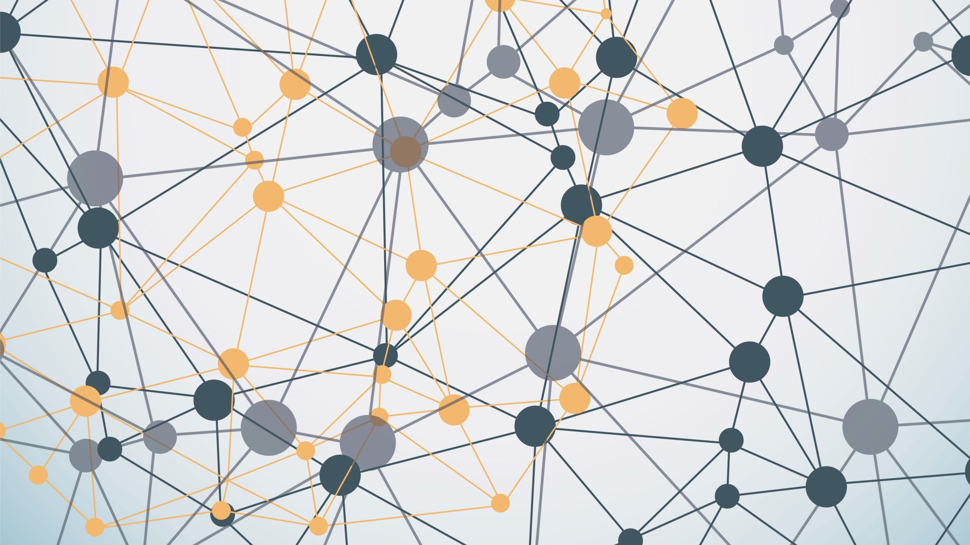
Ad Hoc constructions and resonance

Slide 33
From diagraphs to Ad hoc constructions
 | and | Subj. pronoun | (Aux) + verb | Noun phrase | E
Mary | and | he | can take |  | leave
Alice | and | he | earns |  | leave
Alice |  | he | gets | sick | leave
Alice |  | we | don’t get |  | shit
[(and) + subject pronoun + (auxiliary) + verb + noun phrase]

Slide 34
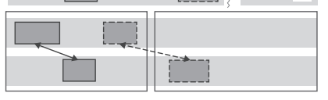
Within-sequence vs. Across-sequence resonance
Within a sequence of conversational actions (e.g. between question and answer / answer and post-expansion), we can have resonance
But resonance can also extend across sequences
What if resonance extends across a conversation – becomes a ‘meme’ between us?
(Rasenberg et al. 2020)
Within
sequence
Across
sequence

Slide 35
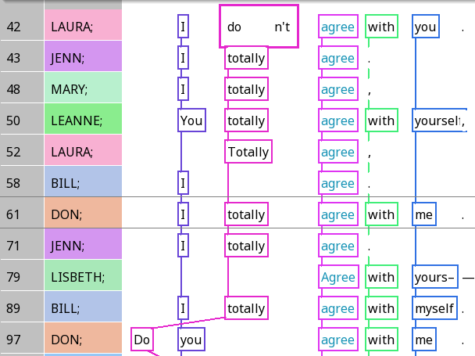
Agreeing with yourself
Any suggestions for the ad hoc construction?

Slide 36
Ad hoc constructions
Part of the ‘conceptual pact’ between speakers in a conversation
Similar to grammatical constructions that are used throughout a community, just more local (between interlocutors)
Can last for quite long, e.g. across sequences
Diamond Sutra: Can you find examples of ad hoc constructions?

Slide 37
For Friday
If you haven’t watched the Friday video, please do so ASAP
Don’t forget the reading (easy) and the quiz
By the end of today, you should have most of your annotation scheme decided, and focus on refining it next week

