Slide 1


LING 194 Week 3 Preparations (1): Adjacency pairs
Ryan Ka Yau Lai
University of California, Santa Barbara

Slide 2
After today, you will…
Clear up misunderstandings about the video, readings, and quiz on Enfield et al. (2018)
Discuss the differential role of questioners and answerers in terms of epistemic authority and sequential agency
Describe how response design modulates epistemic gradients and sequential agency

Slide 3
What is an adjacency pair?
A pair of utterances
Belonging to different turns
Appearing next to each other
The first pair part (FPP) initiates an exchange
The second pair part (SPP) responds to the FPP

Slide 4


Example of an adjacency pair
Hello!
1. Hi!
2. Raccoons are cute.
3. What’s today’s date?

Slide 5
Pair types
For each type of FPP, there is only a limited range of SPPs that make sense
If you give someone an invitation (e.g. Would you like to come to my party?), you don’t expect a greeting (e.g. Good morning)
  i.e. the FPP sets up expectations about the SPP that helps us interpret it
Major focus: questions and answers

Slide 6
Question-answer pairs
Question (FPP): An utterance that asks for a piece of information from the hearer
      Creates an obligation for the recipient to answer
Answer (SPP): An utterance that gives the information sought by the question

Slide 7
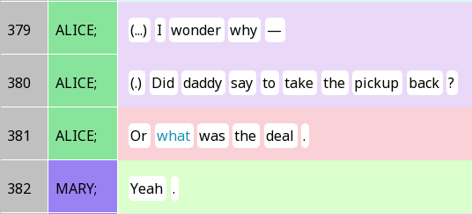
polar and content questions
Content question
Polar question
Content question

Slide 8
Actions performed using questions
Information-seeking questions (classic questions, like just saw)
Requests for confirmation (you kinda know the answer already, just want to make sure)
Understanding checks

Slide 9
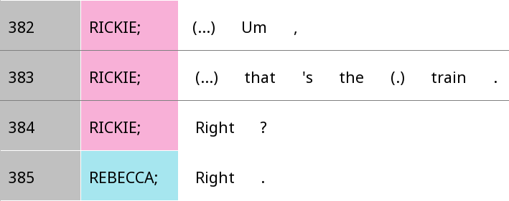
Requests for confirmation

Slide 10
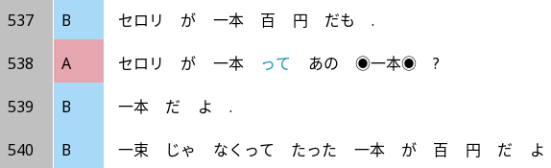
Understan-ding check
Celery is even 100 yen for one stalk.
Celery one stalk tte that kinda one stalk?
It’s one stalk.
Not a bunch, merely a stalk is 100 yen.

Slide 11
How do we respond to questions?
Responses to questions
Non-answers
Counters
Silence, IDK, laughter …
Answers
Interjections
Inserts
Repetition
Transformation

Slide 12
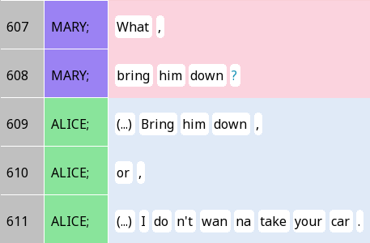

Interjection-type vs repetition-type answers
Interjection / response token (yes/no etc.)
Repetition of elements of the question

Slide 13
Interjection vs repetition: What is explicit vs implicit?
Interjection-type answer | Repetition-type answer
The idea that you’re saying is true or not is implicit True vs. false is explicit | The idea that you’re saying is true or not is explicit True vs. false is implicit

Slide 14

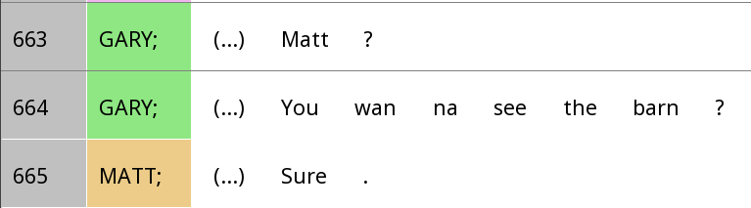
Other interjection-type answers

Slide 15
Things to look out for in your reading
In what situations does an answerer have more agency?
How can an answerer increase their agency in responding to questions?

Slide 16

agency and question-answer pairs

Slide 17

Types of agency
Sequential agency
  Control over the types of social actions performed
  If someone produces a first-pair part, then you are socially coerced into producing a second-pair part
Thematic agency
  Control over what we’re talking about
  If someone produces a question, you’re coerced into talking about the same thing
  Changing the topic in interruptions is an exercise of social power

Slide 18
Answer design and agency
Repetition-type answer: Removes some of the contingency on the FPP
  With repetition, the statement makes sense on its own, even if it were not an answer to a question > More sequential agency
My addition: Perhaps ellipsis would play a role too … (We’ll talk ellipsis tomorrow)

Slide 19
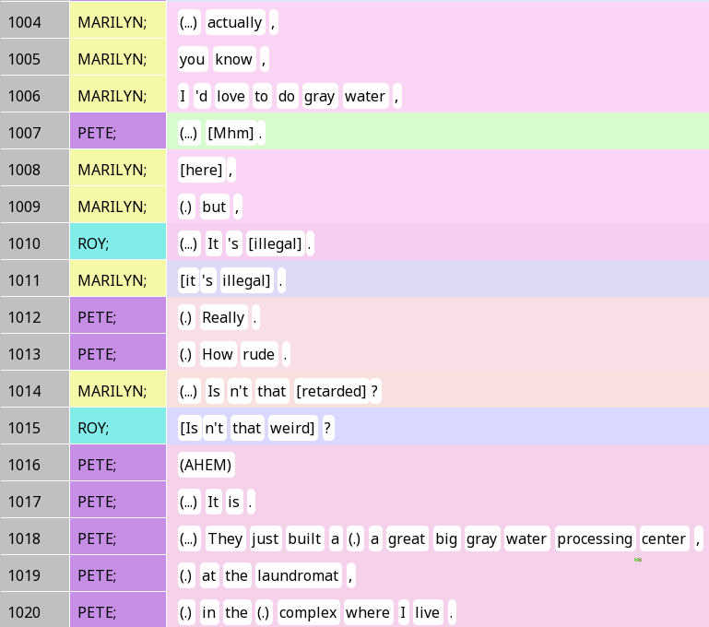
Claiming sequential agency
In line 1013, Pete is the first to express his feelings about grey water being illegal
Marilyn and Roy ask a question, putting Pete in a less agentive position
Roy uses a repetition-type answer as a springboard to a new direction in which the turn takes
(slur)

Slide 20

Epistemics and question-answer pairs

Slide 21
Epistemic access
Epistemic access: Who knows their stuff more about something
Epistemic stance: How do people portray their and others’ epistemic stance?
Epistemic domain: The areas within which you have priviledged epistemic access
In a conversation, people can have more or less privileged epistemic access:
  K+: higher epistemic authority, more privileged epistemic access ‘know your stuff more’
  K-: Lower epistemic authority, less privileged epistemic access, ‘know your stuff less’

Slide 22
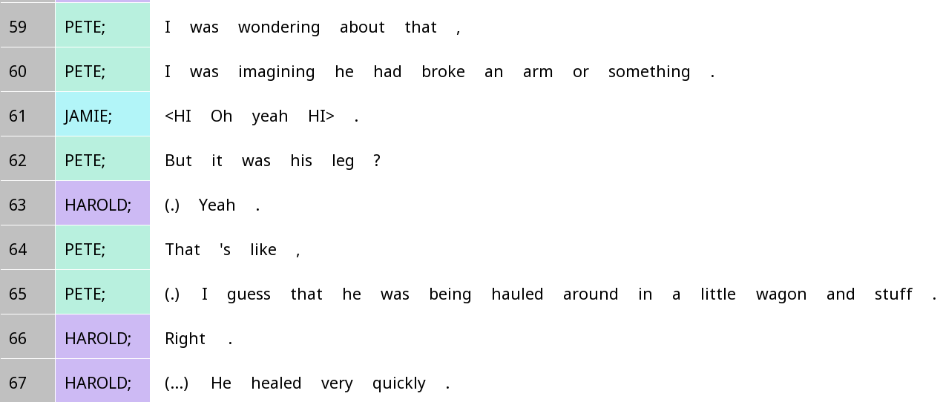
Who ‘knows their stuff’ more about the incident? How can you tell?

Slide 23

Epistemic access and question-answer pairs
Generally: The person who is being asked something has more privileged epistemic access (i.e. should know their stuff more) about the thing being asked about
By asking a question, we usually take an epistemic stance that we know less about something

Slide 24
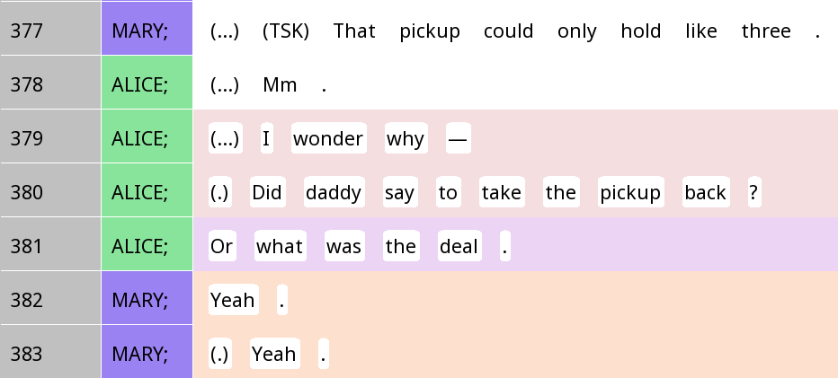
Epistemic domains and the recognition of questions
Sentences with an interrogative grammatical structure can be seen as a real question (information-seeking question) or a fake question (e.g. rhetorical question) depending on one’s epistemic domain
In this example, is Alice K- or K+? How does this influence your interpretation of 379-381?
Qu’estion cascade

Slide 25
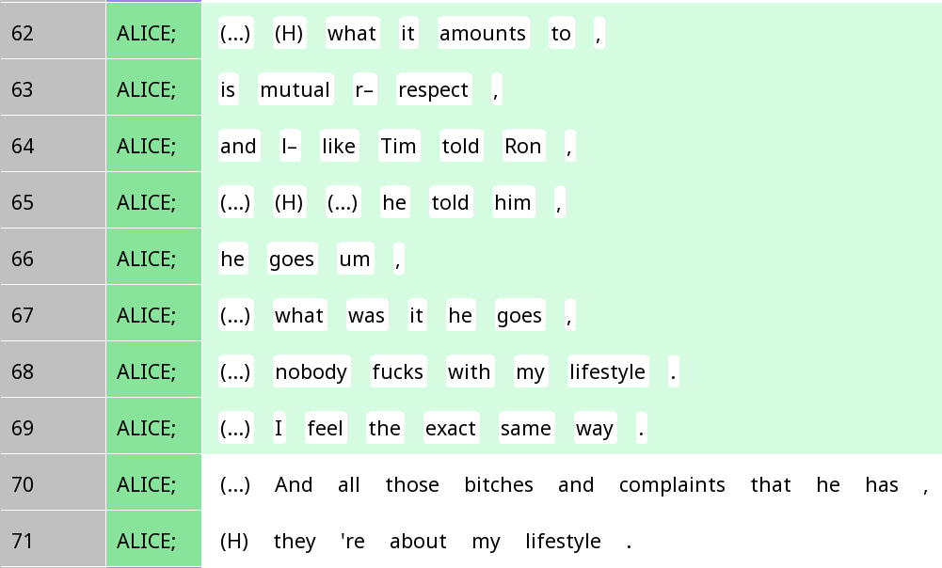
Epistemic domains and the recognition of questions
Sentences with an interrogative grammatical structure can be seen as a real question (information-seeking question) or a fake question (e.g. rhetorical question) depending on one’s epistemic domain
In this example, is Alice K- or K+? How does this influence your interpretation of line 67?

Slide 26
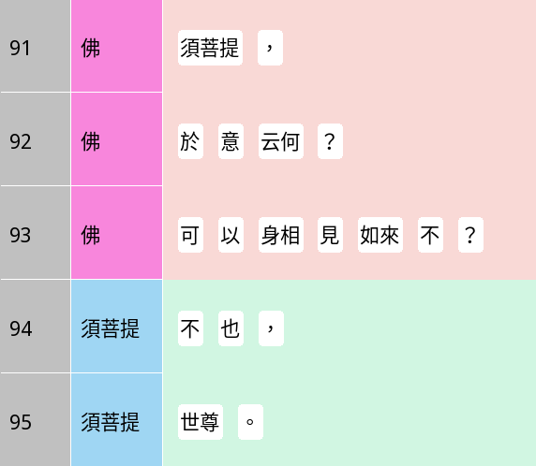
Epistemic domains and the recognition of questions
Sentences with an interrogative grammatical structure can be seen as a real question (information-seeking question) or a fake question (e.g. rhetorical question) depending on one’s epistemic domain
In this example, is the Buddha K- or K+?
Buddha
Subhūti,
What do you think?
What do you think?
Can you see the Tathāgata through bodily characteristics?
Subhūti
No,
Known-answer questions
O Bhagavān.

Slide 27
Epistemic gradients
Do you think Alice is characterising herself as having higher epistemic authority on line 379 and 381, or on line 380?

Slide 28
Epistemic gradients
Alice: K-
Mary: K+
Yeah.
Did daddy say to take the pickup back?
What was the deal?

Slide 29
Epistemic gradients and answer types
Interjection-type answer: ‘Normal’ in terms of epistemic access
Repetition-type answer: Claims epistemic primacy

Slide 30
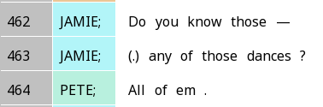
Upgraded answers
Jamie’s question is based on the assumption that the thing to know about is whether Pete knows any of the dances
Pete answers that not only does he know some of the dances, but he actually knows all of them
Epistemic primacy claimed

Slide 31
Sequence and post-expansions

Slide 32
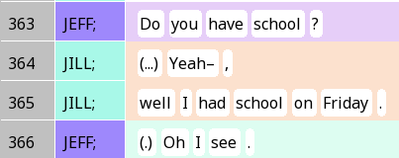
Minimal post-expansions
After a second-pair part, the questioner can acknowledge understanding
What does the oh do here? How does it relate to epistemics?

Slide 33
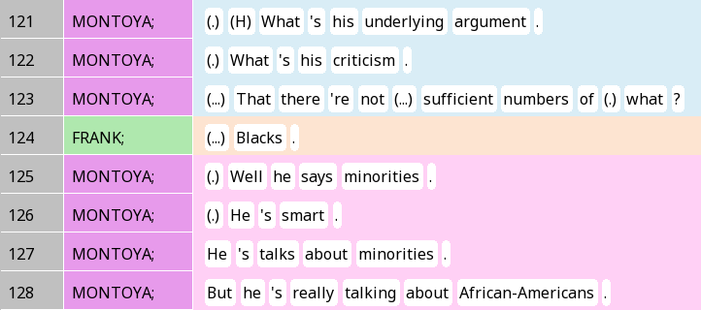
Non-minimal post expansions
After the second pair part of an adjacency pair, it is possible to follow up with a third full turn
In classroom interactions: Initiation-Response-Feedback (IRF) sequence is basic
Group 1: Can you find IRF sequences in the Diamond Sutra?

Slide 34

Group discussion time!
To answer your research question, how might you code for …
  Type of action initiated by questions?
  Form of question?
  Form of answer?
  Epistemic status of the two participants?
Group 1: You can work on your annotation scheme …

Slide 35

For Wednesday
Go through the slides on resonance and the Tantucci & Wang (2021) reading
Do the quiz on T&W
For Group 1, highly recommended that you also watch Friday’s video before the Wednesday class

