Slide 1
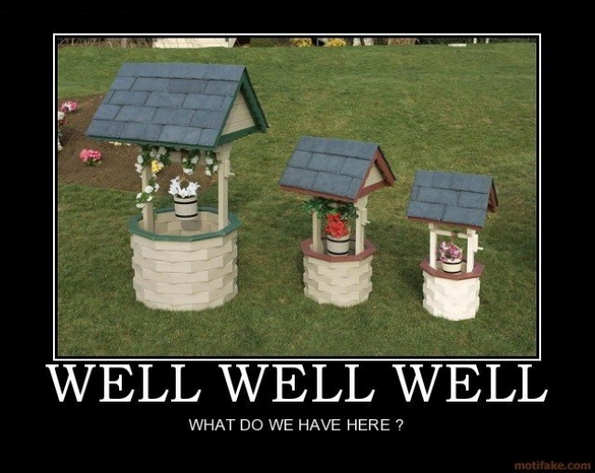
LING 194 Week 2 Class 2: DISCOURSE MARKERS
Ryan Ka Yau Lai
University of California, Santa Barbara

Slide 2
Plan for today
Deepen your understanding of the preparation video, reading and quiz
Discuss the three types of functions of discourse markers
Suggest ways to operationalise distributional properties of discourse markers
Brainstorm ways to investigate discourse markers in relation to your project

Slide 3

DISCOURSE MARKERS
Small words often occurring in conversation
Indicate abstract meanings that are usually difficult to put into words
Work like ‘glue’ that:
  Glue different parts of a conversation together
  Glue us together by helping us navigate interpersonal relationships
ちょっと
bueno
pues
就是說
反正
って
pis
bah
like
so

Slide 4
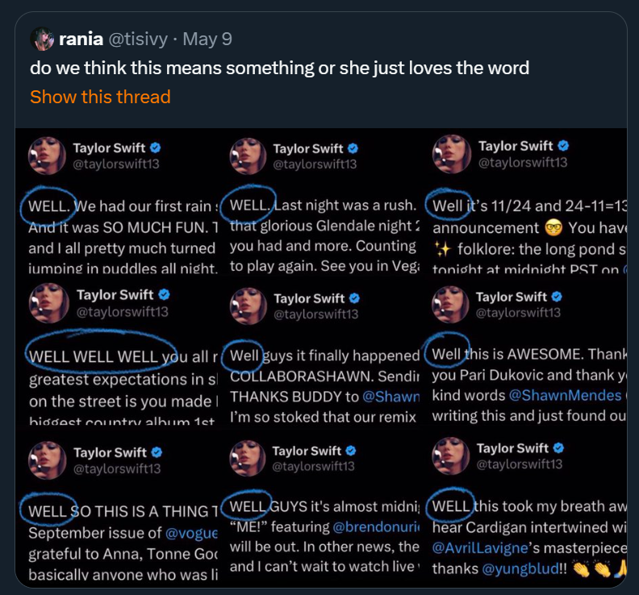
Often derided as ‘meaningless’ …
(ideology of ‘referentialism’)

Slide 5
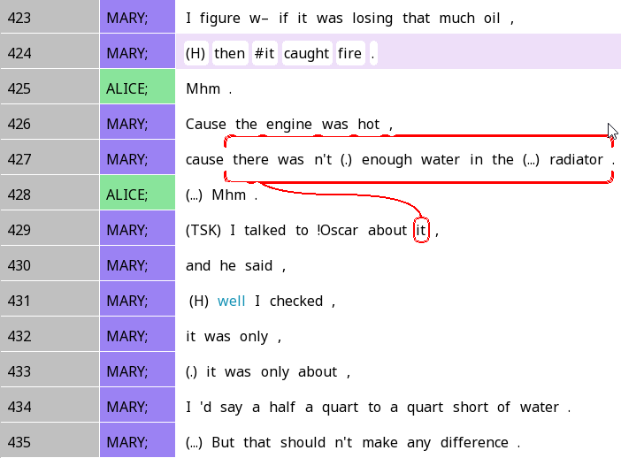
Well …
‘Well’ typically tells us that what’s gonna come is going to not quite what you expect!
DMs tell us the relationship between previous and following parts of discourse
  Responds to preceding context
  Projects (tells us what to expect about) following content

Slide 6
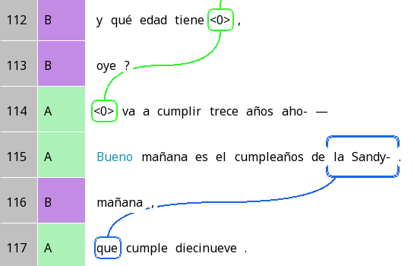
How good is Bueno?
And how old is she,
Bueno is indicating a slight change in the topic
hear?
She’s gonna be thirteen n-
Bueno tomorrow is Sandy’s birthday.
Tomorrow.
Who turns nineteeen.

Slide 7
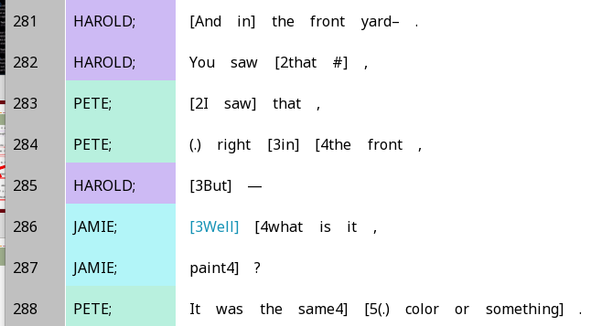
Well …
‘Well’ can be used as a floor-taking device
  Jamie said ‘Well’, at a interjacent overlap (far from TRP)
  A way of taking the floor
DMs can be used for managing interaction

Slide 8
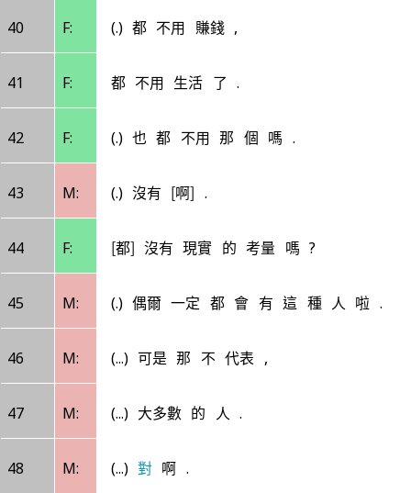
Is ‘對’ duì always ‘right’?
They don’t have to earn money at all
Don’t have to live at all
對啊 is marking the end of M’s turn, and telling F she can speak
Don’t have to that kind of thing?
Nah
Don’t they have real-life considerations?
There will always be this kind of person occasionally.
But that doesn’t represent,
The majority of people.
Duì.

Slide 9
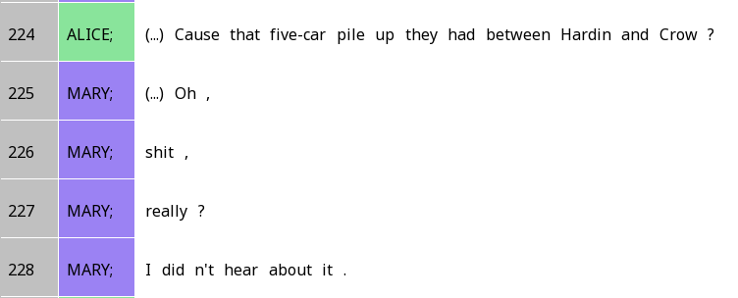
DMs (and interjections) as ‘prefacing’
Interjections and DMs often appear at the beginning of a turn (when you start speaking)
Responds to the previous turn
Prepares for more substantive parts of the turn
Oh: Indicates a change in cognitive state

Slide 10
Placement and function
Discourse markers often play different functions when placed in different locations
Structures that we can place DMs in:
  Intonation units: short burst of speech, =1 line in the Santa Barbara Corpus
  Act / turn-constructional unit (TCU) / utterance: Part of a turn that fully performs an action
  Turn

Slide 11

Locations of discourse markers
Tend to appear at edges of structures, e.g.:
  At the start of a turn: Prefacing, floor taking
  At the start of a TCU/act: Connecting previous TCU to current
  At the end of a turn: Giving up the floor
Fuentes-Rodríguez et al. describe the meanings of pues by dividing them first into locations, and then into specific functions

Slide 12
Let’s think more about the functions of discourse markers, and how to operationalise them!

Slide 13
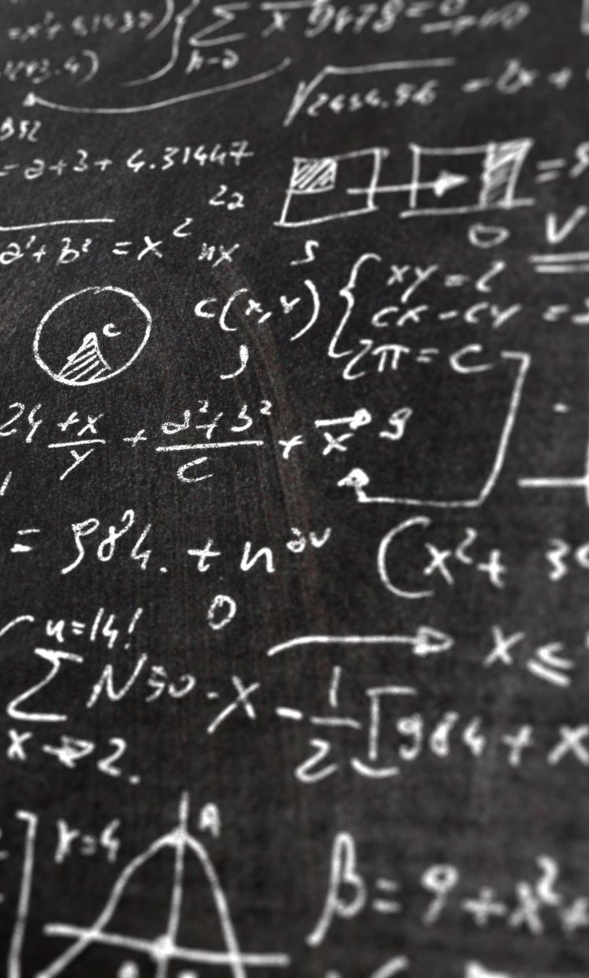
Defining discourse markers
There are several approaches …
We will take the Interactional Linguistics approach from Maschler
Discourse markers = Linguistic signs that serve a metalinguistic purpose
  Metalinguistic = ‘talking about talk’
  ‘employ language in order to communicate about the process of using language itself’ (Maschler & Schiffrin 2015)

Slide 14
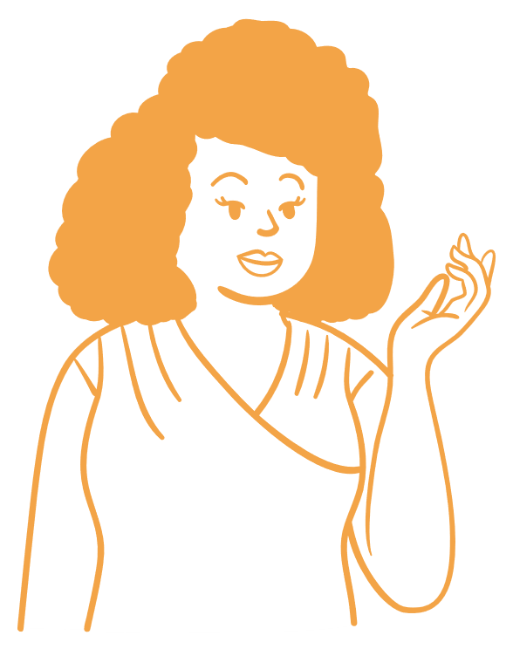
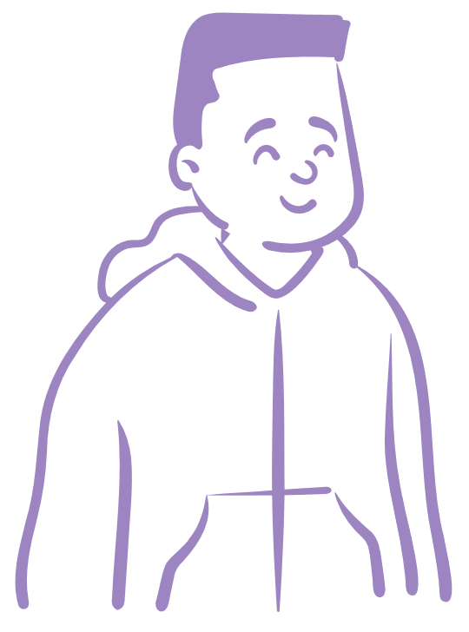
Types of functions that discourse markers perform
1. Textual function: Relationships between different parts of the language

Slide 15
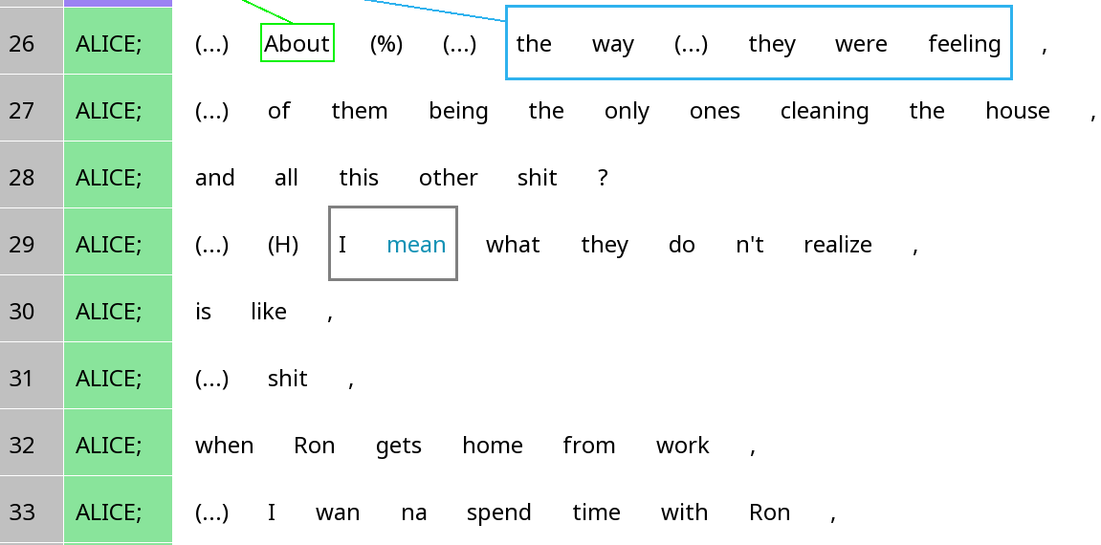
I mean
What textual function does I mean serve?

Slide 16
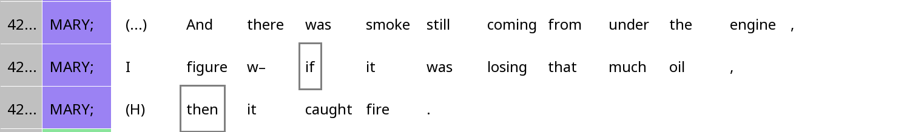
If and Then
What textual function do if and then serve?

Slide 17
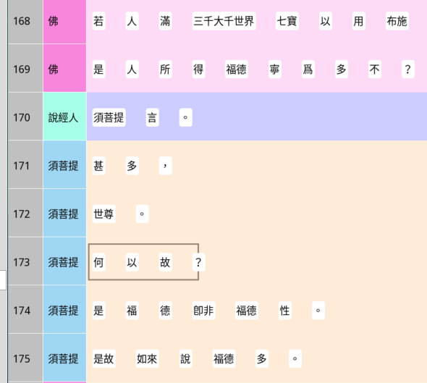
何以故 hé yǐ gù in the diamond sutra
If one fills a trisahasra mahāsahasra lokadhātu for with treasures for charity,
Is the merit obtained by this person great?
What kind of action is being introduced by the ‘why?’
Said Subhuti,
Very great,
Bhagavan.
Why?
This merit is not by nature merit.
Thus the Tathāgata says the the merit is great.

Slide 18
Operationalising textual function
Distribution within discourse units
If a DM connects two units (e.g. TCU with TCU), then we should find it at the edges of that unit type (unless accompanied by other DMs)
Nature of the units being connected
Additive function: The second unit resembles or reinforces the first
Contrastive function: The second unit may be unexpected given the first
Etc.

Slide 19
Types of functions that discourse markers perform
2. Interpersonal function: Relationships between participants / between text and participants
This can be explored in the general framework of stance (Week 4)

Slide 20
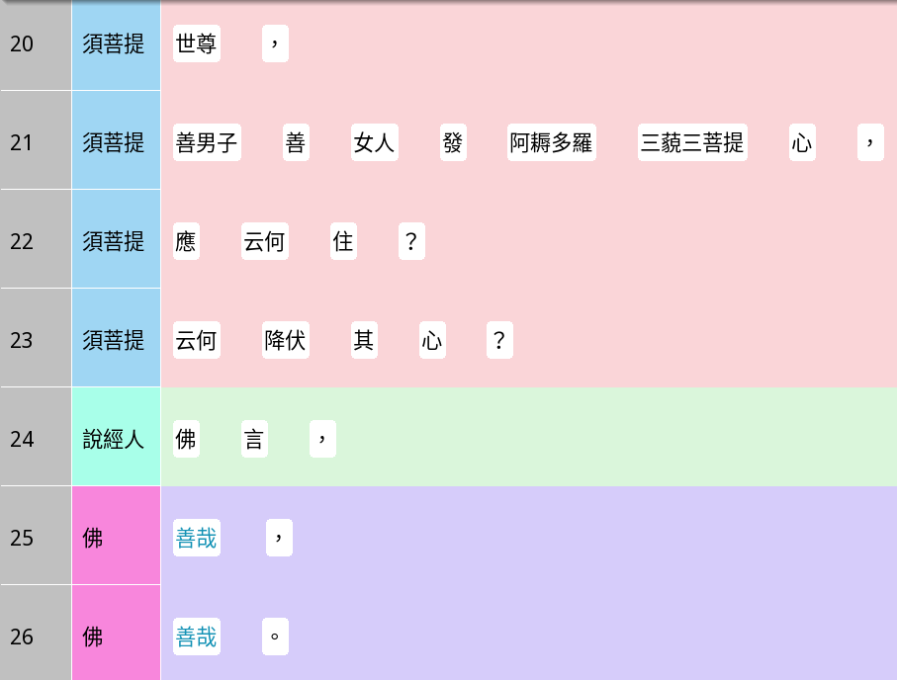
善哉 shàn zāi in the diamond sutra
Bhagavan,
If a noble son or daughter wished to achieve perfect enlightenment
Shàn zāi indicates a subjective relationship.
Between what and what?
How should they remain still?
How should they subdue their hearts?
Said the Buddha,
Well said,
Well said.

Slide 21
‘對’ duì in Mandarin
They don’t have to earn money at all
Don’t have to live at all
Don’t have to that kind of thing?
What kind of interpersonal function is the duì serving?
Nah
Don’t they have real-life considerations?
There will always be this kind of person occasionally.
But that doesn’t represent,
The majority of people.
Duì.

Slide 22
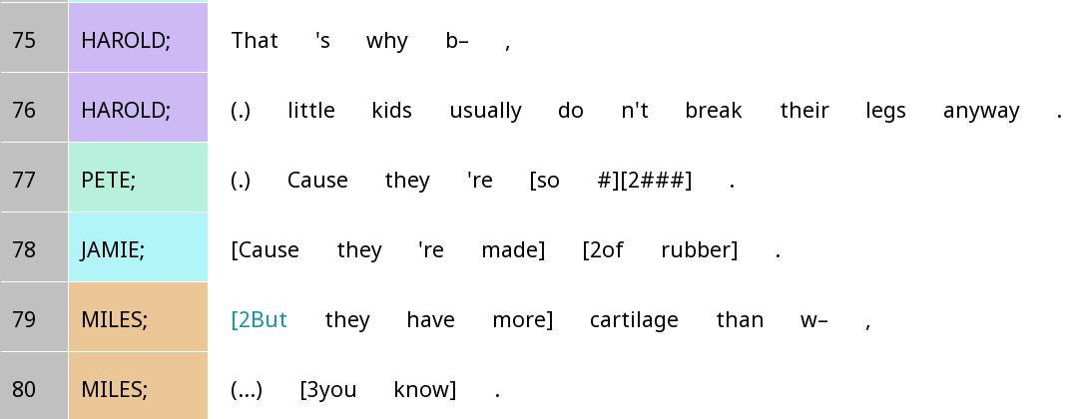
Discourse markers can be multifunctional!
What textual function does but do?
What interpersonal function does the but serve?

Slide 23
Operationalising interpersonal functions
This is a huge topic
We’ll come back to this in Week 4 when we discuss stance
But for now, let’s think about interpersonal functions related to turn-taking and floor management

Slide 24
Operationalising interpersonal functions
Function type | Position in turn | Nature of the turn | Prosody
Floor-taking | Turn-initial | Substantive turn, i.e. with other content after Interruptions | Relatively fast
Floor-yielding | Turn-final | After a long turn (e.g. multi-unit turn) | Final prosody (rising / falling in English) Lengthened
Floor-holding | Turn-medial |  | Preceding pauses Relatively slow
Backchannel | Only word in ‘turn’ | Only word in ‘turn’

Slide 25
Types of functions that discourse markers perform
3. Cognitive function: Communicating one’s cognitive state

Slide 26
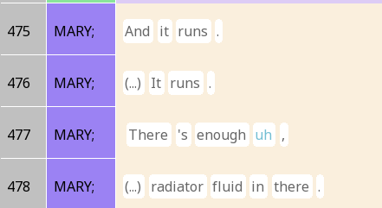
Floor-holding devices: Fillers / hesitation markers / filled pauses
What cognitive phenomenon does uh indicate?
How about interpersonal function?

Slide 27
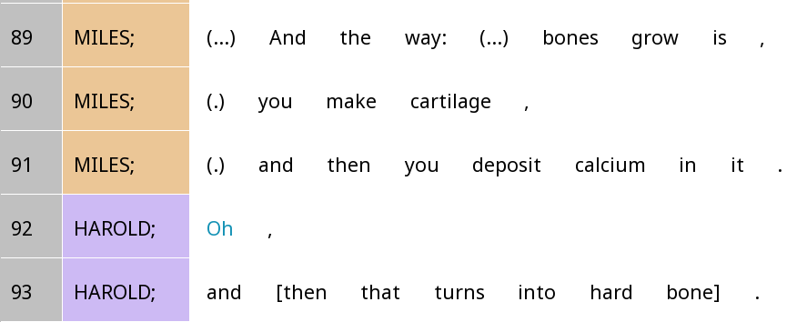
Oh-prefaced turns
What cognitive phenomenon does oh indicate?
What textual function does oh do?
How about interpersonal function?

Slide 28
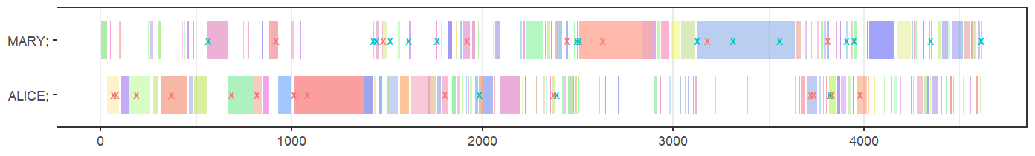
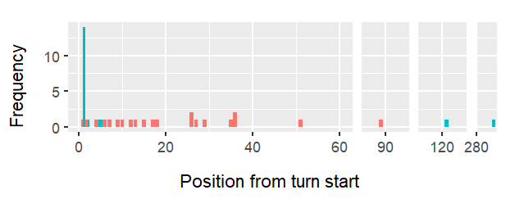
From my paper …
Compare the positions of like (red) and oh (blue). What do you find?
What might this say about the functions of like and oh?

Slide 29

Discussion time!
Get in groups and discuss:
  What kind of discourse markers do you find in your texts?
  Which ones are relevant to your group project?
  Can you think of any hypotheses about your DM?
    How would you test such hypothesis?
  Otherwise, how would you go about investigating your DM?
    Any visualisation methods?

Slide 30
For friday …
Read the (quick) Rezonator tutorials on stacks and chunks
Watch the video on turn-taking in Rezonator (those who have taken 170 may skip parts of it)
  Try out the features on Rezonator as you watch. Practice is important!
Complete the quiz
Think about how you will implement stacks in your project, and bring the ideas tomorrow

