Slide 1
LING 194 Week 2 Class 1: Turn-taking and interruptions
Ryan Ka Yau Lai
University of California, Santa Barbara

Slide 2
Any questions about the preparation video, the reading or the quiz?
Ask away …

Slide 3
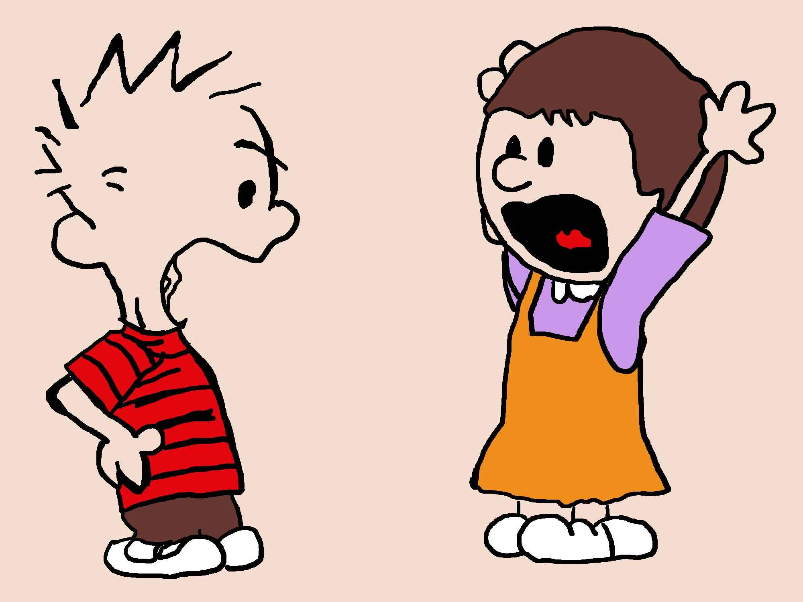
Turn-taking
When we are talking, we take turns to talk
Usually, one person is talking - having the conversational floor - at a given time
  We avoid talking simultaneously
  We avoid awkward silences
However, there are exceptions to this …

Slide 4

What does ‘interruption’ mean to you?
Think about …

Slide 5
Possible conceptions of interruption
When two people are speaking at the same time (simultaneous talk)
When one person starts speaking before the previous person has finished saying what they want to say (Tao: ‘folk’ definition of interruption)
When we try to take the floor / the right to speak from the other person, when they haven’t given it up

Slide 6
Some things to consider when defining interruption …
When did the overlap happen? (Timing)
Does the new speaker try to take the floor? (Floor)
What is the new speaker’s intention? (Action)

Slide 7
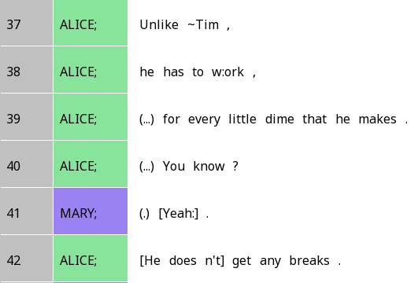
Is this an interruption?
Mary (line 41) talks at the same time as Alice (line 42)
Is this interruption?

Slide 8

How humans take turns to speak
Whenever we speak, we need to determine when is the right time to chime in
We constantly monitor the other person’s language
And we try to jump in right at the moment that their turn is finished (‘no gaps, no overlaps’)
To do this, we try to start speaking at transition-relevance places (TRPs)

Slide 9
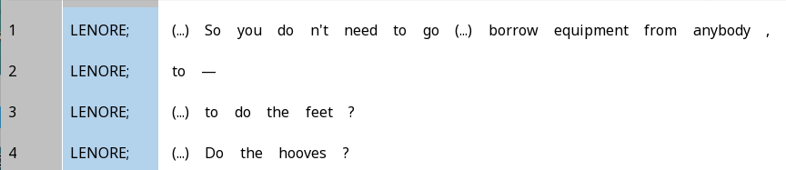
Transition-relevance place (TRP)
A point in the conversation where someone’s turn may end
We try to time our contributions so they start right after TRPs!

Slide 10
Transition-space overlap
The overlap we just saw is called transition-space overlap
  Because it happened around the same time as a TRP where a new turn could potentially start
Definitions of interruption typically exclude transition-space overlap, because people are still ‘following the rules’ of good turn-taking

Slide 11
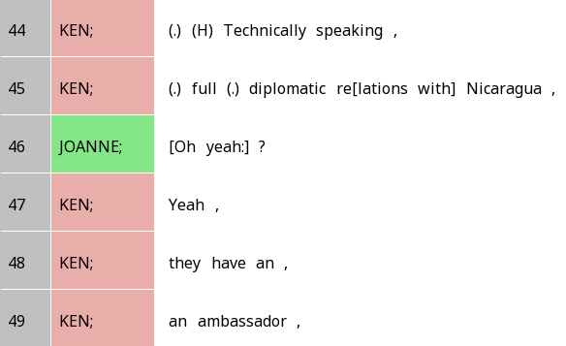
Interjacent overlap
You jump in when the other person clearly hasn’t finished
‘Diplomatic re…’ is clearly not the end of Ken’s turn
But Joanne jumps in anyway because she challenges Ken

Slide 12
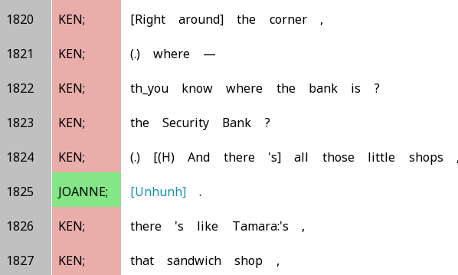
Backchannels: Not taking the floor
Used to express that you understand what the other person is saying and align with them without taking the floor from them
Generally do not count as interruptions

Slide 13
What kinds of actions more likely count as interruptions?
Finishing someone’s sentence for them?
Empathising with someone?
Challenging someone?

Slide 14
Thinking more deeply about (attempted) speaker transitions

Slide 15
Some operational definitions
Overlap = simultaneous talk
  This is different from Tao’s definition
Floor = The right to produce substantive language
Interruption = perceived disruption of the turn-taking system
  Subjective and subject to cultural variation

Slide 16
‘Normal’ speaker transitions
According to the traditional Sacks-Schegloff-Jefferson model of turn taking, this is what happens when we talk:
  One person (S) speaks at a time
  When S is speaking, other people monitor the speech for transition-relevance places (TRPs)
  Other people will start speaking at TRPs if they believe S is done
  Approximately, this leads to a ‘no gaps, no overlaps’ situation – seamless transition between speakers at TRPs

Slide 17
Does overlap = interruption?
Let’s say we think of interruptions as deviations from the usual turn-taking system
This means overlap that is allowed under the usual turn-taking system would not be interruptions
Can you think of some ways this can happen?

Slide 18
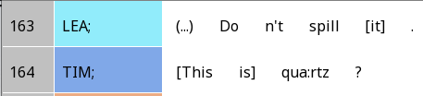
Transition-space overlap
Transition-space overlap generally does not count
When we listen to others speak, we guess where the TRP will be based on what they’ve said so far
We might miss by a bit, and overlap with the end of the other person’s turn
(SBC048)

Slide 19
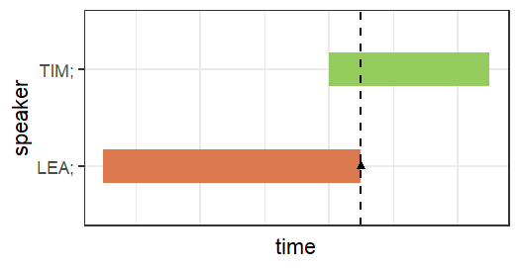
Gantt chart - overlap between original and backchannel
Short distance between new speaker’s start and old speaker’s TRP
Value | Maps to …
Start of a turn/backchannel | x-axis – beginning of segment
End of a turn/backchannel | x-axis – end of segment
TRP location | x-axis – position of triangles
Speaker | y-axis – position of segments and triangles
Code for generating this graph is on Google Drive!

Slide 20
Transition-space overlap – overlap between original and backchannel
At a TRP, the original speaker may continue to speak, or a new speaker may join in and/or produce a backchannel
Sometimes, the original speaker wants to continue past the TRP right away, but a new speaker adds a backchannel, resulting in overlap

Slide 21
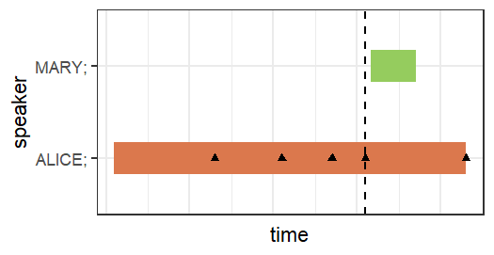
Gantt chart - overlap between original and backchannel
Short distance between new speaker’s start and old speaker’s TRP
Value | Maps to …
Start of a turn/backchannel | x-axis – beginning of segment
End of a turn/backchannel | x-axis – end of segment
TRP location | x-axis – position of triangles
Speaker | y-axis – position of segments and triangles
Code for generating this graph is on Google Drive!

Slide 22
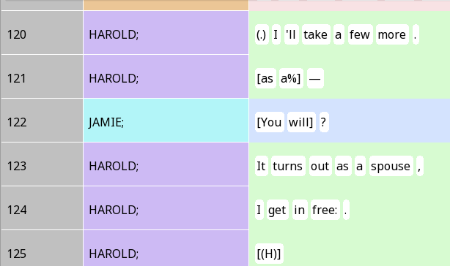
Transition-space overlap – competition between original and new speaker
Harold has a TRP at 120
Jamie tries to jump in at the TRP but Harold continues past the TRP
Try to sketch out a Gantt chart for this one!

Slide 23
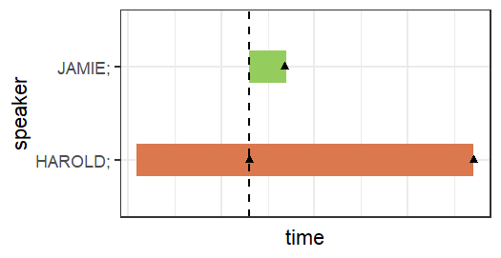
Transition-space overlap – competition between original and new speaker
New speaker’s start = old speaker’s TRP
Mappings are the same as previous ones
This time, the TRP and the start of Jamie’s turn are perfectly aligned
But then, Harold’s turn continues past the TRP instead of ending at the TRP

Slide 24
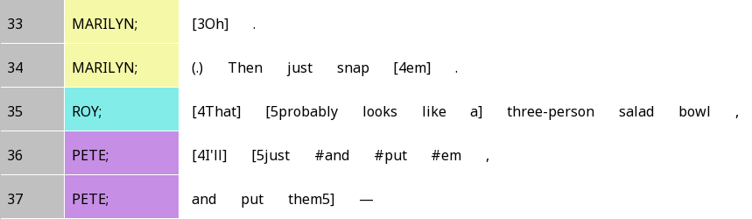
Transition-space overlap – turn competition between two new speakers
Transition-space overlap generally does not count
When we listen to others speak, we guess where the TRP will be based on what they’ve said so far
We might miss by a bit, and overlap with the end of the other person’s turn

Slide 25
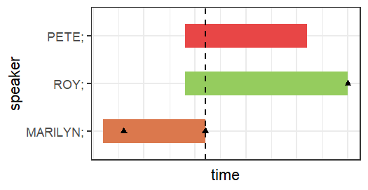
Transition-space overlap – competition between new speakers
Transition-space overlap between new speakers and old speaker
Turn competition between new speakers
Mappings are the same as previous ones
This time, Pete and Roy both have brief transition-space overlap with Marilyn
Then they engage in competitive overlap over the floor post-Marilyn’s TRP

Slide 26
Interjacent overlap: Actually an interruption?
Recall this example of interjacent overlap or ‘deep’ overlap
The start of the overlap is not close to a TRP

Slide 27
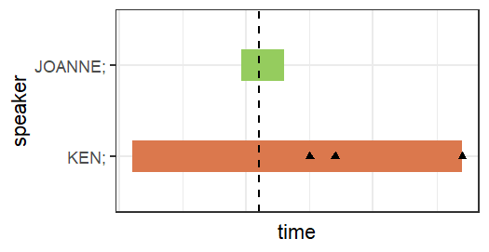
Transition-space overlap – competition between original and new speaker
New speaker’s start far from old speaker’s TRP
Mappings are the same as previous ones
Start of Joanne’s turn not synced with any TRP

Slide 28
Does starting before the other person has finished = interruption?
All these transition-space overlap tell us that starting before the other person has finished doesn’t always mean ‘interruption’ in the way we normally think of it
Let’s try another possible characterisation: Starting before someone has finished talking
In more precise terms: Starting to speak in a way that is not anchored at a TRP

Slide 29
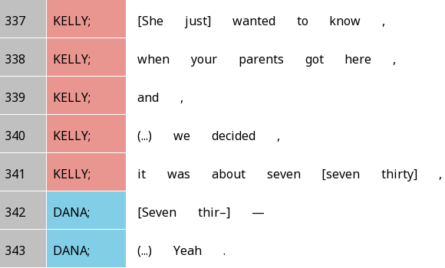
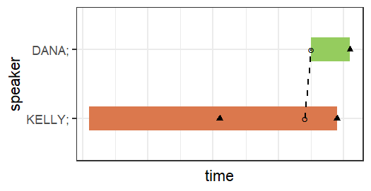
Turn co-construction
Dana jumps in a fair bit before Kelly’s TRP
But Dana completes Kelly’s sentence!
Co-completion symbolized by dotted line
cf. Zhang, Li and Zhang (2021)

Slide 30
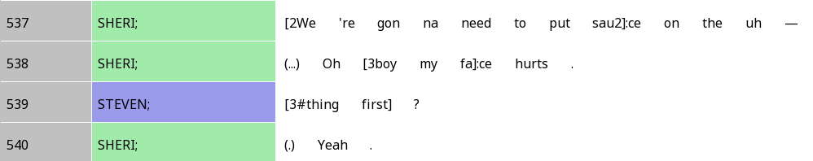
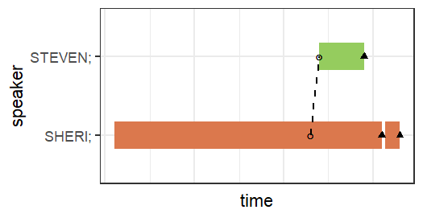
Turn co-construction with a filler
Here, Sheri produces a filler, indicating trouble in finding the right word
After Sheri gives up to say something new, Steven tries to complete Sheri’s original utterance
The fact that Sheri was producing a filler perhaps makes Steven’s co-completion even less disruptive …

Slide 31

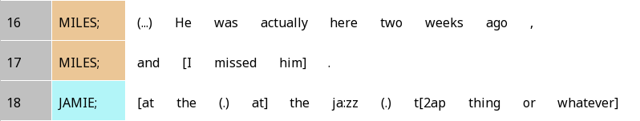
Co-Construction vs. turn increment
Here, Jamie is continuing off the second TRP from Miles
Grammatically, Jamie’s utterance belongs to the same sentence as Miles
But it follows a TRP, unlike the co-construction examples we saw
This makes it an increment instead of co-construction

Slide 32
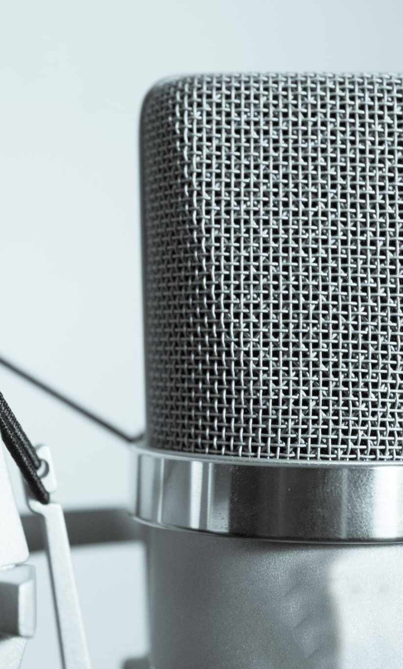
Conclusion so far …
Interruptions are complicated!
  Overlaps may not be the same as interruption
  Starting to talk before the other person finishes may not be seen as interruption either
Other things to consider:
  Is the new speaker just adding a backchannel? Something slightly more substantive? Something very substantial?
  Is the new speaker aligning with the previous speaker positively (e.g. agreement) or negatively (e.g. disagreement, changing the topic)

Slide 33


Interpersonal variation also matters!
Not everyone interacts in the same way
What one person finds to be disruptive / interrupting might not be disruptive to someone else
We need to consider conversational style

Slide 34
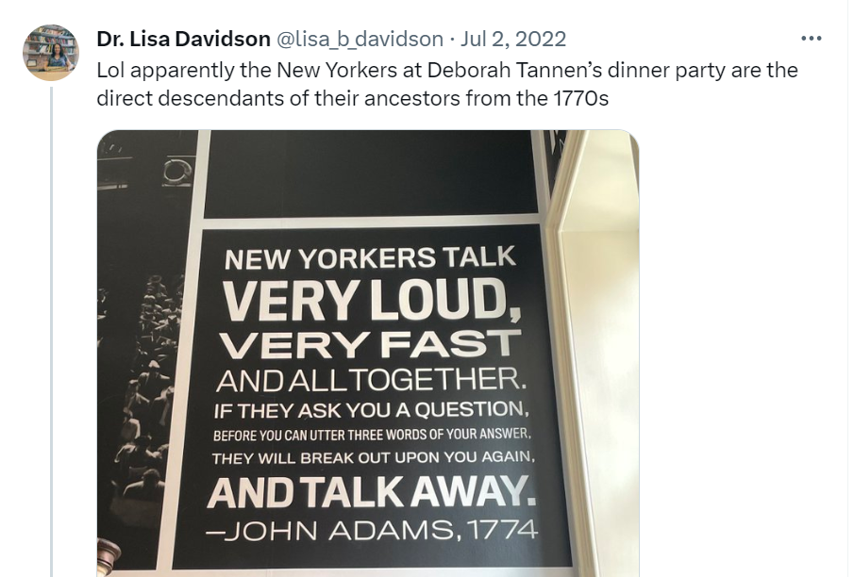
High-involvement vs high-considerateness styles
From linguist Deb Tannen
High involvement (NYers): Value faster turn-taking, cooperative overlap
High considerateness (non-NYers): Value not imposing on others more
Tao (2022): Chinese speakers are high-involvement on the phone

Slide 35
Operationalising types of speaker transition
‘Depth’ of overlap
Number of syllables from TRP (traditionally: >2 syllables = interruption)
Did the overlap take place before or after the nuclear accent of the last IU?
Size
Backchannel/Minimal response, 1 clause, >1 clause …
Stance
Agreement/Disagreement, Same topic vs Switch topic …
Grammatical relationship with prev. turn
Co-construction, increment, resonance, no relationship

Slide 36

Some final thoughts
Because ‘interruption’ may be an ideological term that means different things to different people, it might be better to think about (attempted) speaker transitions
Each (attempted) transition can be coded for different properties that make it more collaborative vs more disruptive
We might then examine the distribution of those features across participants, genders, cultures …; examine how they are perceived by different people (as disruptive vs collaborative)…

Slide 37
Discussion time!
Get in groups and think about:
  How would you characterise a speaker transition?
  How can you code for the different characteristics of speaker transitions?
    At what level (anchor)?
    With what fields and tags (body)?
  What are some ways we can analyse the resulting data?
Make sure we finish the discussion before 3pm so we can hear the excellent presentations!

Slide 38
Now let’s listen to some great presentations from Lily and Meryl Grace!

