Slide 1

LING 194 Visualising language in conversational interactions: An overview of the process
Ryan Ka Yau Lai
University of California, Santa Barbara

Slide 2
While we’re waiting …
Sit with your group members
Continue the conversation on what you want to do in your project
Open Rezonator for ideas

Slide 3
After this class, you will be able to …
Identify linguistic signs
Distinguish between the form and function of a linguistic sign
State the distributional hypothesis and describe how it helps us study linguistic signs
Explain the research questions and methodology used in the three readings
Explain what linguistic annotation is
Describe the basic workflow in this class

Slide 4

Ways we examine linguistic phenomena

Slide 5
Do you know what these words mean?
oh
pues
well
indeed
喔

Slide 6
Do you know what these patterns mean?
Tag questions: You aren’t John, are you?
Locative inversion: Down the street you go (instead of You go down the street)
Quotatives: She was all / was like / went + quote

Slide 7
Linguistic signs
Resources that help us solve recurring problems in human interaction
Form of a sign: The sounds/hand sign etc. it’s made up of
Function of a sign: What the sign is used for

Slide 8
Types of linguistic forms
Words and phrases
Parts of words (e.g. –ing)
Grammatical patterns
  Word orders (Here we go vs We go here)
  ‘Constructions’ – patterns that include grammatical words and places to put content words
    Adjective-ass
    Person + be all / be like / go + quote

Slide 9
Types of linguistic functions
Textual functions: Indicate relationship between different parts of the conversation
  Example: The word well tells people that you’re going to say something that is unexpected in the context
Interactional functions:
  Example: The word uh-hunh tells people that you understand what they mean and gives them a green light to keep talking
Social functions:
  Example: Nerds use she went + quote, popular kids use she was all + quote (Bucholtz 2002)
……

Slide 10
Common ways to study linguistic phenomena
Form-to-function
  Start from a form as the thing we’re studying
  Then study its function and situations of use
  Like writing a dictionary entry
Function-to-form
  Start from a broad function that we perform through language (e.g. answering a yes/no question)
  Then find forms that perform that function
  Finally examine nuanced differences in function or situation of use between those forms

Slide 11

The distributional hypothesis
‘You shall know a word by the company it keeps’
To examine what function a linguistic sign performs, the best way to do it is to look at when people use it, i.e. distributional properties
  What kinds of words, phrases, sentences, etc. tend to come before or after it?
  Where does it occur within an utterance?
  What kinds of person tends to use it?
  How do people tend to respond to it?

Slide 12

Simple example: What if we want to know the function of yuck?
It tends to occur near other words like eww, gross, disgusting
People tend to frown when they say it
People who portray themselves as tough and strong (and so less likely to express emotion) are less likely to say it
Conclusion: It is used to express disgust.

Slide 13
Two ways to use distributions
Comparing different functions of a single form
Comparing different signs / presence vs absence of a form
Compile all instances of but
For each instance, note distributional properties (e.g. where it occurs in a sentence: in the middle of a clause or between two clauses?)
Look at whether you can separate the different instances into two piles (He is but a boy vs He is a boy but he is smart)
Compile all instances of be all, be like and go
For each one, note distributional properties (e.g. who is saying it, whether it occurs with other words like totally)
Compare the difference in distribution between the three signs)

Slide 14


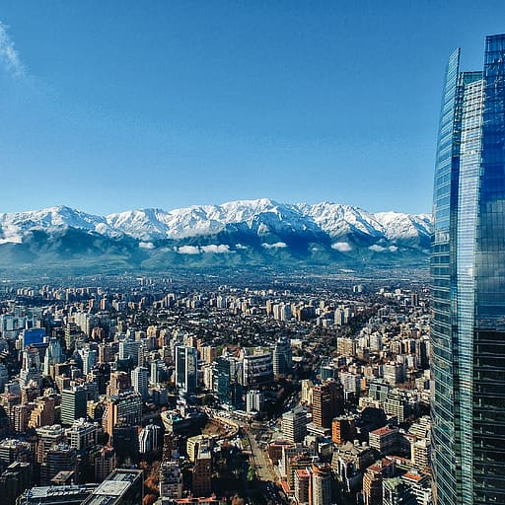

Gonzáles Temer (2014): Click sounds in Chilean Spanish

Slide 15
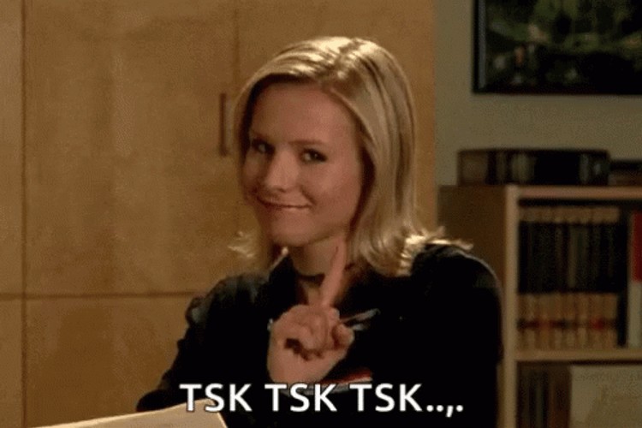
Linguistic sign studied
Clicks (tsk-tsk)
Functions mentioned in the literature (Section 1.2)
  Signal a change of topic
  Tell people you’re trying to find the right word
  Show disapproval

Slide 16
Methodology
Form-to-function: Start with the form (click), discover what functions it performs
Comparing different functions of a single sign
Three functions, each with its own distributional properties

Slide 17
Function 1: Incipient speakership
At the start of a turn: Tell the other person you are about to speak
At the start of a TCU (roughly a sentence or sentence fragment): Tell the other person you want to keep talking
At the start of a sequence (thing to talk about): Starting a new topic

Slide 18
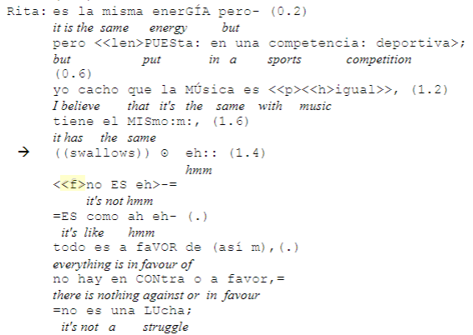
Function 2: Signalling a word search
The click ʘ tells people that you are trying to think of the right word

Slide 19
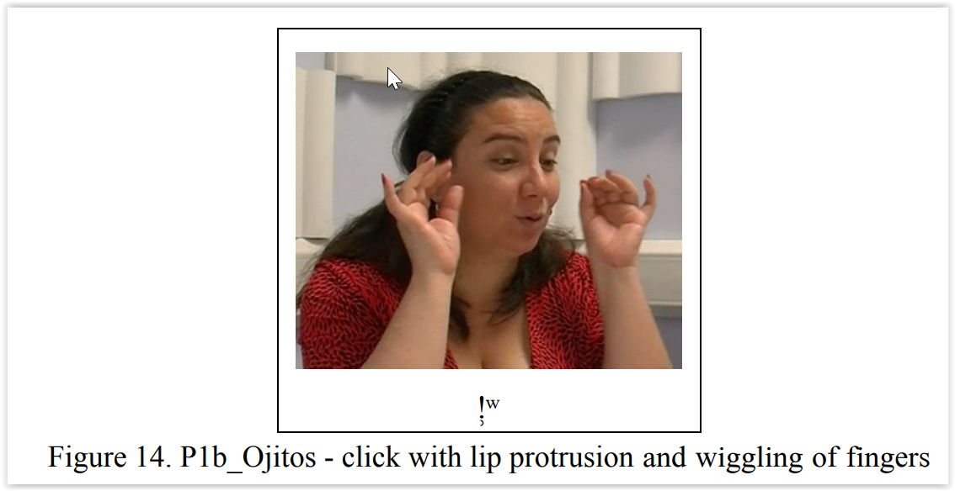
Function 3: Stance
Beginning of the turn
Click + ah: Change of state, e.g. ‘Oh, now I get it’
When accompanied by gestures: Part of a larger package

Slide 20

Guo, Zhou & Chow (2012): Compliments in Mandarin spoken in Shanghai

Slide 21
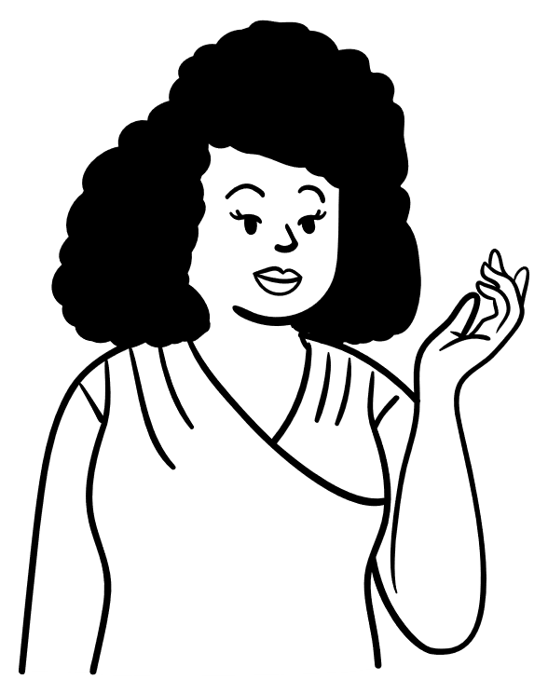
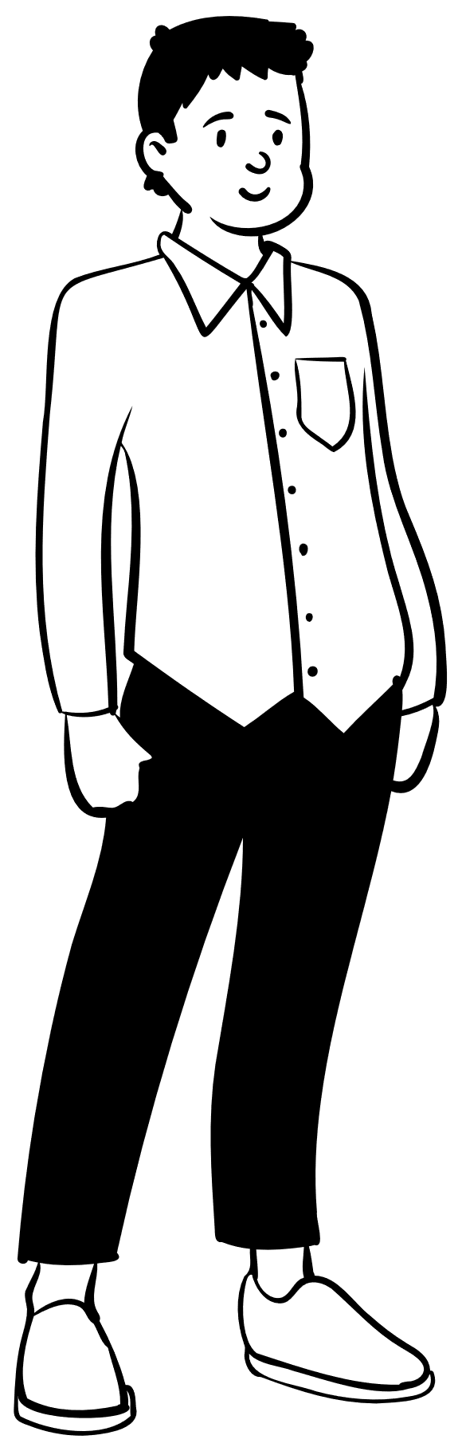
Linguistic signs studied
Semantic formulas for responding to compliments
  Acceptance formulas
    e.g. appreciation: ‘Thanks’
  Indirection formulas
    e.g. explanation: ‘Oh it was just lucky’
  Non-acceptance formulas
    e.g. downgrade: ‘Oh I’m not that good’
You’re so good at this!
…

Slide 22
Methodology
Function-to-form: From function (compliment response) to functional types of forms (semantic formulas for responding)
Predicted form type from:
  Demographic factors: gender, age, education, English use, class
  Relationship between the people: social status differential, social distance
  Topic (appearance, personality, etc.)

Slide 23
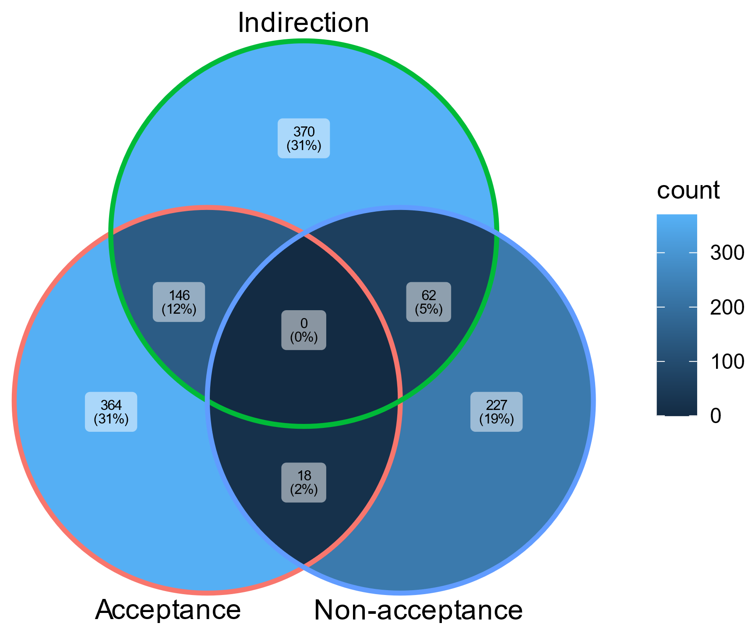
Results
Indirection is most common, followed by acceptance and non-acceptance
Note: The visualisations in this paper have substantial room for improvement. You are welcome to discuss why in the weekly report!

Slide 24
Results – predictive modelling
Factors contributing to higher acceptance rate:
    Closer social distance between speakers
    Being young, e.g. there is a change whereby people are getting more likely to accept compliments

Slide 25

Shin & Otheguy (2009): Spanish pronouns in NYC

Slide 26
Linguistic sign studied
Spanish singular subject pronouns
Person | Form
1st (I) | Yo
2nd (you) | Tú
3rd (she, he(, they)) | Ella, él(, elle)

Slide 27
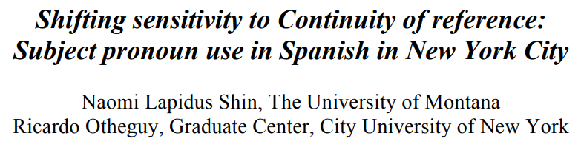
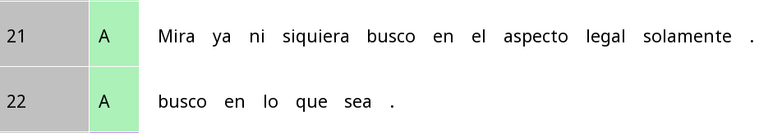
Spanish in NYC vs. Spanish in Latin America
Look (I) am not even looking just in the legal aspect.
(I) am looking everywhere.
Mira (yo) ya ni siquiera busco en el aspect legal solamente
look (I) already not even look in the aspect legal only
(Yo) busco en lo que sea.
(I) look in that which be
Is the choice whether to use pronouns the same for everybody?

Slide 28
Same reference vs switch reference
Same reference
Switch reference
Subject of previous clause = subject of current clause
Int: ¿Y tu papá terminó su licenciatura?
(And your dad finished his Bachelor’s?)
Part: Nada más. (Nothing more.)
<0> se dedicó a otras cosas,
((<0>) dedicated himself to other things,)
Expectation: chances of using a pronoun
Subject of previous clause = subject of current clause
Part: Ella tenía su novio allá
(She had her boyfriend there)
y él pensaba venir
(And he thought about coming)
Expectation: more likely to use a pronoun

Slide 29
Methodology
Function-to-function: Start with the context of use (switch vs same reference)
  As well as generation in the United States
Comparing presence vs absence of a class of signs

Slide 30
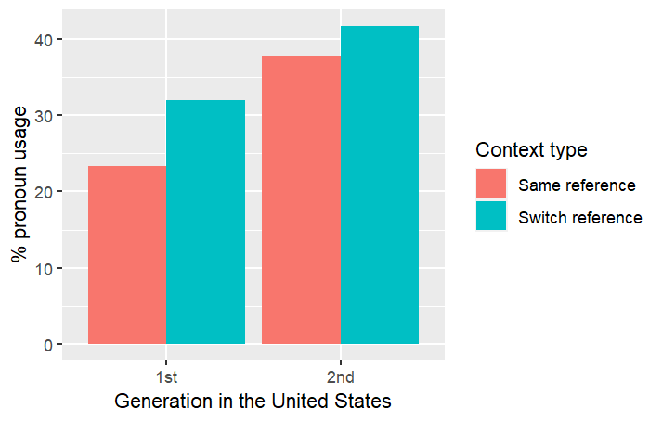
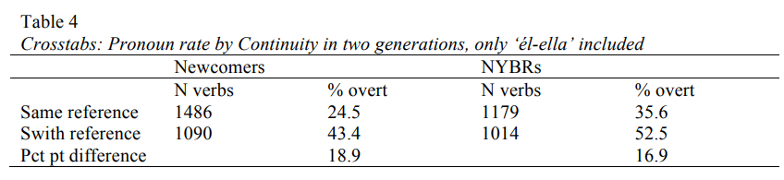
Is everyone affected by same vs switch reference the same way?
All subject pronouns | First-gen | Second-gen
Same reference | 23.3% | 31.9%
Switch reference | 37.8% | 41.7%
Difference | 14.5% | 9.8%
Second-generation Latinos in NYC use pronouns more overall
Less affected by same vs switch reference

Slide 31
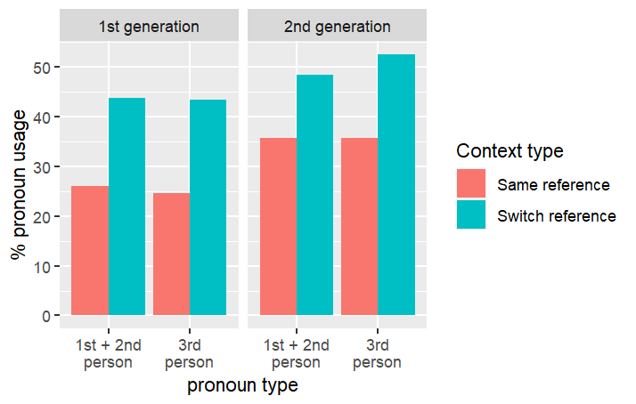
Do communicative ease shape these differences?
Third-person only | First-gen | Second-gen
Same reference | 24.5% | 35.6%
Switch reference | 43.4% | 52.5%
Difference | 18.9% | 16.9%
First/second-person only | First-gen | Second-gen
Same reference | 26.0% | 35.7%
Switch reference | 43.7% | 48.4%
Difference | 17.7% | 12.7%

Slide 32
Discussion time!
Hopefully, you’ve come to a conclusion on the main theme you want to study in these six weeks.
Try to think of the methodology now

Slide 33

Linguistic annotations

Slide 34
What is an annotation?
Any extra information that we append to a text
Most annotation consists of two parts (Marshal 2010):
  Anchor: The scope of the text that your annotation applies to
  Body: The annotation itself
Used in most fields in the humanities and social sciences
You have probably done annotations before, informally (e.g. what you might be writing on your slides right now)
Any extra information that we append to a text
Used in most fields in the humanities and social sciences
You have probably done annotations before, informally (e.g. what you might be writing on your slides right now)
Incl. linguistics?
OMG

Slide 35
What makes a good linguistic annotation?
Systematic
  Most of the time, annotations belong to a fixed set of categories
  With clear definitions on when to put a category
Reliable
  If two people annotate the same text, they should get good match in results
    Inter-annotator agreement: Measures of how close people’s annotations of the same text are
  (There are disagreements about this in recent years, but in this class we’ll stick to the traditional view!)

Slide 36
Annotations in Rezonator
Fields = ‘variables’ that can be attached to Rezonator objects (e.g units and tokens)
Tags = a particular value of a tag
We will have some hands-on practice on Friday
Field: Tense
Tags: Past, Present, Future
Field: Gender
Tags: NB, F, M, Mixed
Field: Number
Tags: Singular, Plural

Slide 37
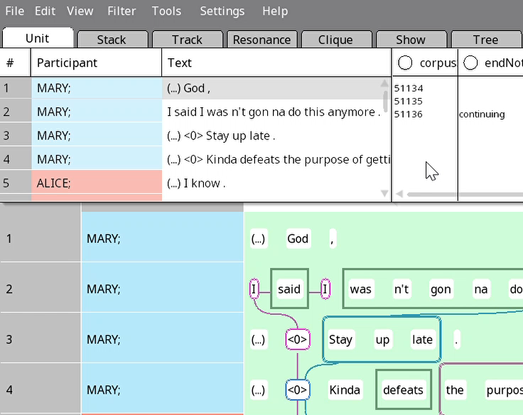
Try this: Enable Word tip and Unit tip in Rezonator

Slide 38
Annotation schemes
On a computer:
  Most basic form = A list of fields plus associated tags
  Some more advanced software have complex annotation schema structures; Rezonator’s is relatively simple
For humans:
  Include criteria and examples for:
    Determining the anchor (what part of the text an annotation applies to)
    Choosing the correct tags
  Guo, Zhou & Chow had an example!

Slide 39
From annotations to data tables
To analyse and visualise data, it needs to be in a table format
Typically, each line of a table represents one data point
type | social_dist | gender | topic | …
acceptance | friends | m | appearance | …
indirection | family | f | possession | …
acceptance | strangers | m | performance | …
… | … | … | … | …

Slide 40
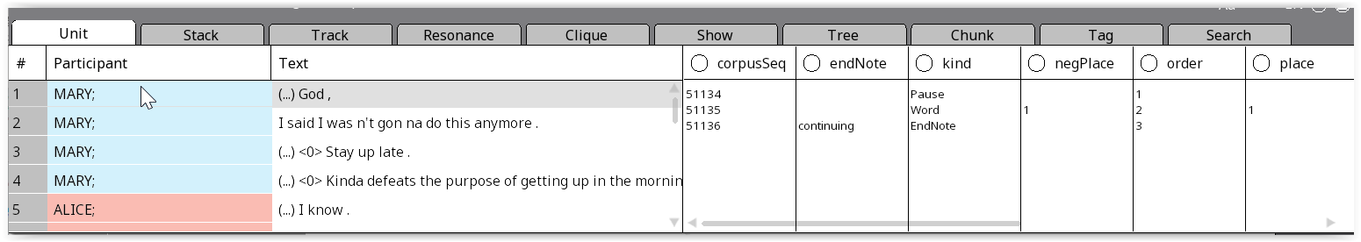
Data tables and Rezonator
The Rezonator nav window gives us some information in this format:
However, this is often not the most useful format, and you cannot use it in R

Slide 41
Data tables in rezonateR
rezonateR converts your Rezonator annotations into a series of data tables (called rezrDF)
Allows you to manipulate the data in different ways
We’ll cover this in detail Week 4!

Slide 42

Basic workflow in this class

Slide 43
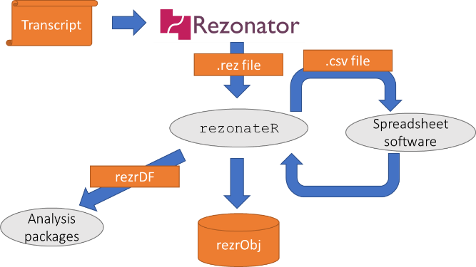
Flowchart from Lai (under review)
Focus of Week 2 + 3
I’ll work with you on this part if needed on Week 1
Focus of Week 4-6

Slide 44
Flowchart from Lai (under review)
We first need to get our data (transcripts) and convert it into a format suitable for Rezonator (we’ll discuss this on Friday).

Slide 45
Flowchart from Lai (under review)
Then we will carry out annotations inside Rezonator. The annotations are saved in a .rez file.
Focus of Week 4-6

Slide 46
Flowchart from Lai (under review)
Finally, we will import the annotations in R, turn the annotations into graphs.

Slide 47
For Friday
I assigned the first two chapters of the Rezonator guide (note: some button positions are out of date) + my paper on rezonateR
  You can skip Section 3.3 if you want
Don’t worry about understanding everything – this is just to give you a general idea of what Rezonator and rezonateR do
Remember to choose a paper to present
We’ll discuss on Friday:
  Basics of computer formats for transcripts and their conversion
  The details of doing span annotations in Rezonator

Slide 48

Now for discussions!
In the remaining time for today:
  Finalise your group topic and dataset
  Discuss what linguistic sign you selected and what methodological approach (form to function vs function to form, etc.) you will take
You can write about what we discussed today in your weekly report!

