Slide 1

LING 194 Visualising language in conversational interactions: Introduction
Ryan Ka Yau Lai
University of California, Santa Barbara

Slide 2
In this class, we will …
Introduce ourselves
Explain what this course is about
Explain the assessment structure of this class
Get started with Rezonator and discourse-functional transcription
Form groups and start discussing your project topic

Slide 3
Who am I?
I’m your instructor this quarter
Ryan Ka Yau Lai 黎嘉祐 [lɐɪ˨˩ kɑ˥ jɐʊ˨]
4th year PhD student in linguistics at UCSB
Work on corpus-based discourse & grammar studies
Languages I work with: Classical & Central Tibetan; Old & Middle Chinese + modern Cantonese & Mandarin; English; Japanese; P’urhépecha (Indigenous language of Michoacán, Mexico)
Office hours: M/W, the hour after class, SH 5431 G

Slide 4

Topic of this class

Slide 5
Foci of this class
Computer-aided, corpus-based approach to analysing conversation
  Bring a laptop to every class
  Unfortunately, Chromebooks and tablets do not work for this class
Emphasis on visualising conversation
Object of analysis is linguistic phenomena

Slide 6
Philosophy of this class
Issue-based, inquiry-based learning
We will focus on how to tackle specific research questions using conversational data
  Focus not on understanding the details of linguistics theories
  Learn whatever you need to answer the research question
Assessment takes place in the form of multiple low-stakes tasks building up to a final project
No big exam or paper
Programming background welcome but not needed – I will make sure everyone succeeds in this class regardless of background, as long as you put in the effort

Slide 7
Linguistic phenomena to analyse
Words
well, oh
Phrases
I mean, you know
Grammatical constructions
You know + NP?, tag questions
Actions
questions and answers, agreements and disagreements
Interactional phenomena
backchannels, interruptions

Slide 8




Linguistic concepts
Turn-taking and interruptions
Discourse markers
Adjacency pairs
Resonance
Stance
Footing
[If you’ve taken relevant classes, feel free to use other things you’ve learnt: Information structure, referent accessibility, social deixis, repair sequences, epistemic upgrading and downgrading …]
We will only scratch the surface of each topic! The point is to give you an idea of how each of these work, and it’s your responsibility to go deep (using the optional readings) if it’s relevant to your project

Slide 9
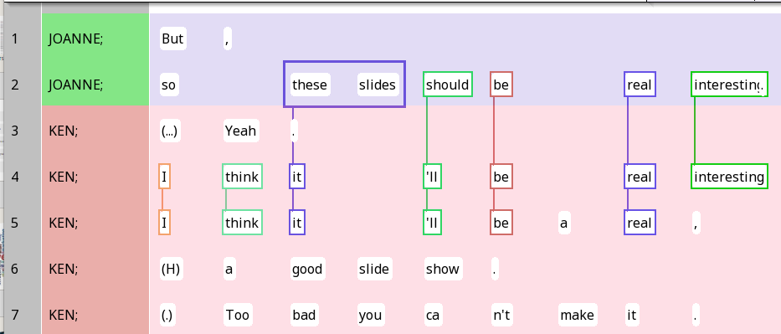
Qualitative visualisations
(concrete)
Conver-sational transcripts
Text segmen-tation
Span annotation
Chain annotation

Slide 10
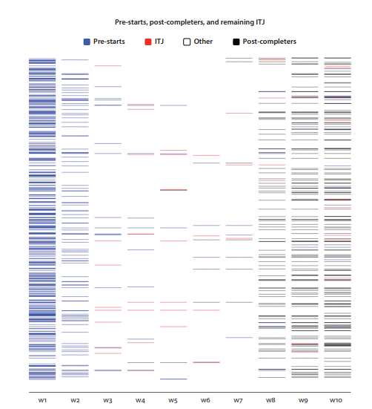
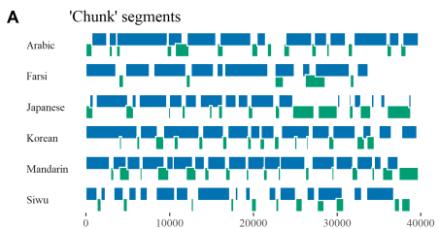
Qualitative visualisations (abstract)
(From textbook)
(Dingemanse & Liesenfeld 2022)
Gantt charts
Location plots

Slide 11
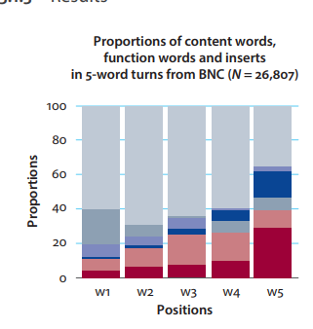
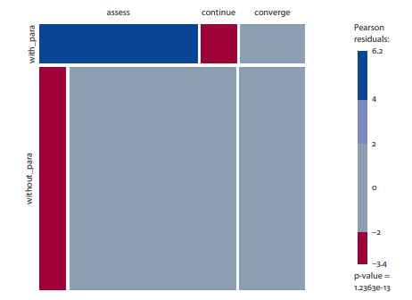
Quantitative visualisations
Bar graphs
Mosaic charts and association charts
Dendrograms and icicle plots for hierarchical clustering
Biplots for correspondence analysis (time permitting)
Conditional inference trees
(From textbook)

Slide 12
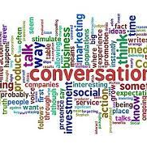
What this class does not cover (unfortunately)
Visualisations on properties of texts, rather than linguistic phenomena
Multimodality
Advanced morphosyntactic phenomena
Narrative and procedural discourse
(If you are familiar with the first three, still free to use them in your project, but talk to me first)

Slide 13
Note on datasets
It must be possible for your dataset to be imported into Rezonator
If you want to use your own dataset (other than the Santa Barbara Corpus, Spanish & Japanese CallHome, and ChatGPT), contact me by 2pm Wednesday so I can decide whether the data is feasible to use

Slide 14

Structure of this class

Slide 15
Assessment
5% Pre-class mini-quizzes 8% Five-minute paper presentation 42% Weekly individual reports (x6, 7% @) (Due at noon on the following Monday) 10% Annotation scheme (Due Friday, Week 4) 8% Final group report draft (Due on noon Monday, Week 6) 12% Final group presentation (On the last day of Week 6) 15% Final group report (Due on Wednesday of finals week)

Slide 16
Required readings and mini-quizzes
Core of the course
Our in-class discussions will be focused on them
You don’t have to understand everything in the readings!
Mini-quizzes: Designed to tell you what to focus your attention on and check your understanding
  You don’t always need to read all of the reading in detail
  Focus on the parts I quiz you on!

Slide 17
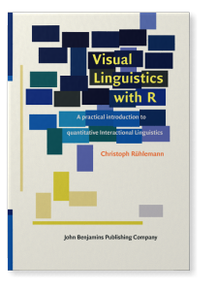
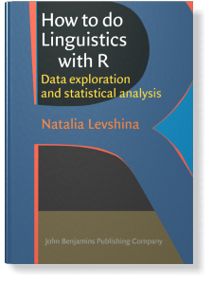
Textbooks
We will read chapters from these
Mostly the second half of the course
Have the same issue-based structure as our class

Slide 18


Preparatory slides/videos
On every Friday, I will give you preparatory slides/videos
Each one is tied to a specific day of the following week
On basic concepts and basic computational techniques
Go through them before you read the required readings for each day
Purpose:
  Help you understand the readings
  Save class time
    Gives you time to work on the project in class, where I can help you directly

Slide 19

Optional readings
You will present at least one optional reading in class in five minutes (8% of the course grade)
You can’t go through everything the reading says
So give us the most interesting take-aways from that reading from our class, e.g.
  Ways of annotating data
  Visualisations that work well
  …
I will give a demo on Wednesday

Slide 20
Weekly individual reports
Designed to track progress
Four components:
Class progress
Reading response
Project progress
Project plans
Details: Modules > General information > Guidelines for weekly individual reports

Slide 21
Project
Main component of the class
Your progress will be constantly monitored
You will:
  Set a topic to explore
  Find a dataset to analyse
  Device an annotation scheme (we’ll talk about that later)
  Annotate texts using the scheme
  Use the annotations to create quantitative graphs

Slide 22

Examples of research questions
What are the differences in the uses of mira, fíjate and oye in Mexican Spanish?
How do men construct themselves as having higher authority than women (‘mansplaining’) and prevent women from speaking (‘manterruptions’)?
In Buddhist scripture, does the Buddha answer questions from arhats and bodhisattvas differently from how arhats and bodhisattvas answer questions from the Buddha?

Slide 23
Examples of datasets
Santa Barbara Corpus of Spoken American English
We’ll use it today
CallHome corpus (English, Spanish, Mandarin, Japanese …)
CallFriend corpus
Transcripts of your favourite TV shows / movies / talk shows
Drama scripts
Scripture containing conversation
ChatGPT transcripts

Slide 24

Get in groups now …
Brainstorm topics to explore …

Slide 25

Intro to Rezonator

Slide 26
What does Rezonator do?
Display
Display conversational transcripts
Visualise
Visualise relationships between different parts of conversation
Store
Store data in a format for quantitative analysis
Search
Search conversational transcripts to find language phenomena of interest
We will learn most of these things soon:
https://rezonator.com/features/

Slide 27
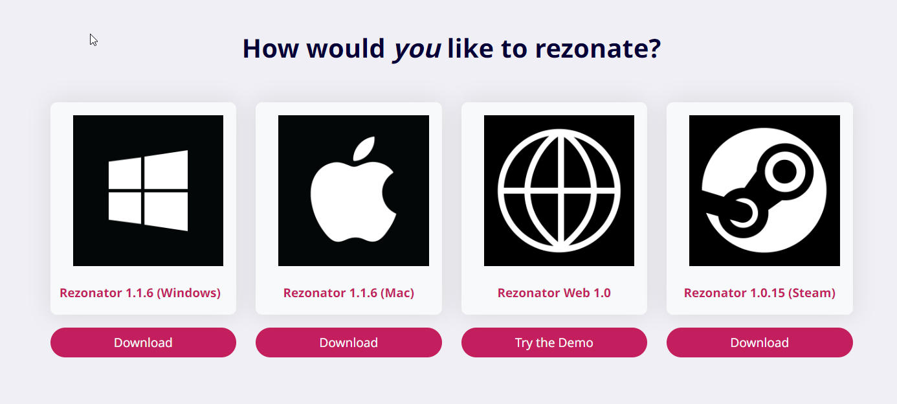
Installing Rezonator
https://rezonator.com/download/
Unzip the file and run Rezonator.exe
Video guide (especially for Mac users facing issues): https://rezonator.com/guide/

Slide 28
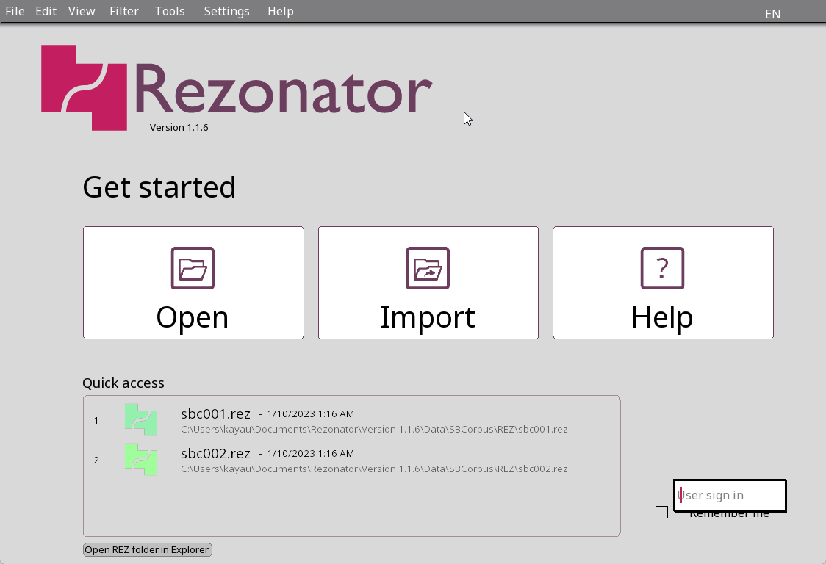
Opening Rezonator
The start screen should look like this (may be in your system’s language)
You can change the language on top right
Note: If you want my help in class, please change the language to one I can understand (English, Chinese, Japanese or Spanish)

Slide 29
Opening a transcript – quick access
Try to open the second file in ‘Quick access’

Slide 30
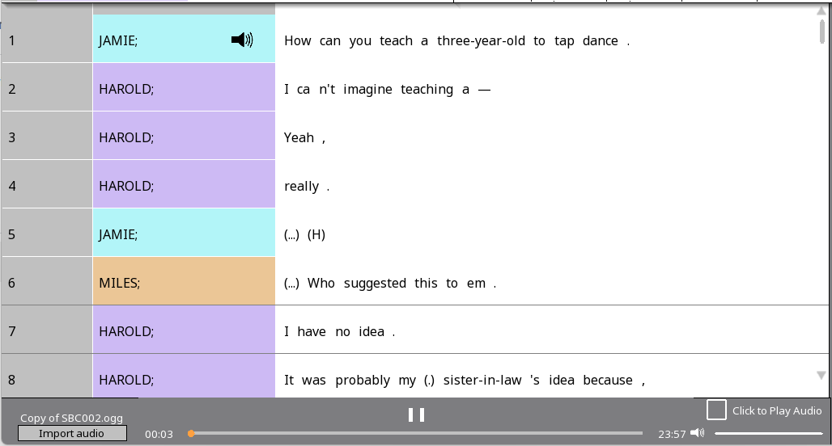
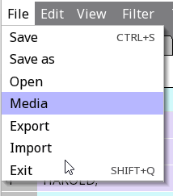


Downloading media files
Go to the class Google Drive at shorturl.at/eBCKR (full link available at Canvas)
Download file at 'Corpus > Santa Barbara Corpus > ogg 124 > Copy of SBC002.ogg’
Open in Rezonator using File > Media
Now you should see a media bar at the bottom
Note: You cannot open a media file alone – you must have a transcript open!

Slide 31
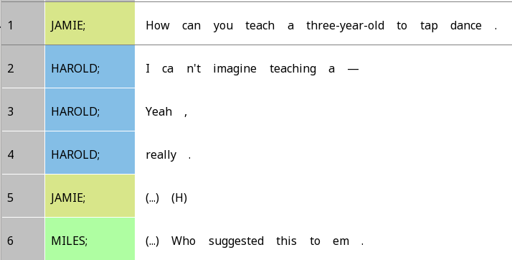
Units
Each line in Rezonator is called a unit
In the Santa Barbara Corpus, every line is an intonation unit – we’ll learn what that means later
Numbered: Shown here are 1-6
Line numbers
Participant labels

Slide 32
Tokens
In the text, each element separated by a space is a token
Largely words, but also:
  Contractions : n’t
  ‘Punctuation’ – we’ll learn about what they mean exactly later
  Pause: (…)
  Breath: (H)

Slide 33
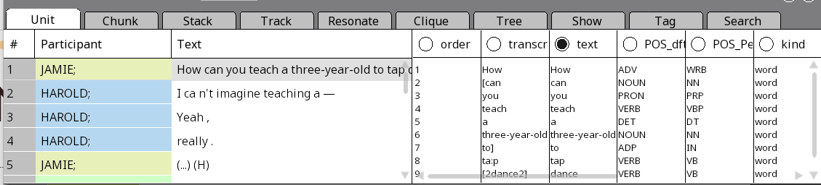
Navigation window
For the first part of this class, we will use only the Unit tab
Left part: Each line is a unit
Right part: Each line is a token in the currently active unit

Slide 34
Text vs. Transcript
Right part: Each column is a property of the token
The selected column (solid dot) = what gets shown in the main screen
What if you click on the circle next to ‘transcript’?

Slide 35
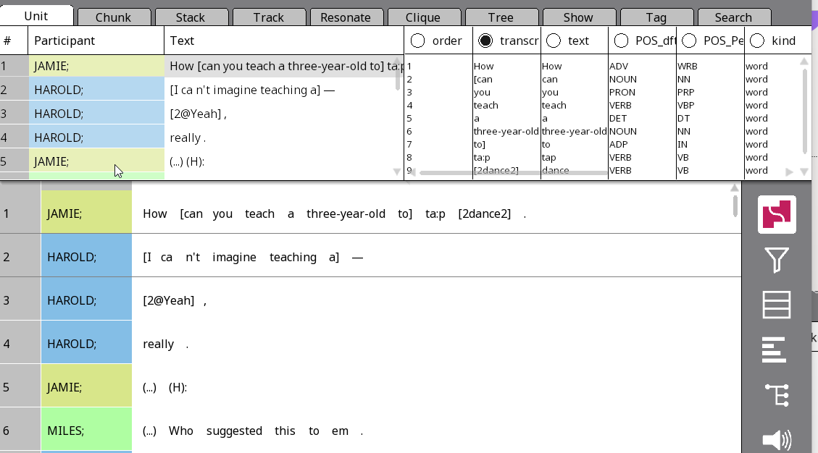
Text vs. Transcript
Now the transcript looks less ‘clean’!
We get:
  Overlap brackets ([ ], [2 2])
  Laughter quality (@)
  Lengthening ((H):)

Slide 36
Common transcription conventions
Convention | Meaning
(H) | Inbreath
(Hx) | Exhalation
@ | Laughter
(TSK) | Tsk-tsk
Convention | Meaning
(.) | Shorter pause
(…) | Longer pause
# | Unclear
[ ] | Overlap brackets
wor:d | Lengthening

Slide 37





One-to-many vs. one-to-one
Right now, we are in one-to-many view: One unit on the right side, many tokens on the left side
What if you click on the one-to-many button on the right-hand sidebar?

Slide 38
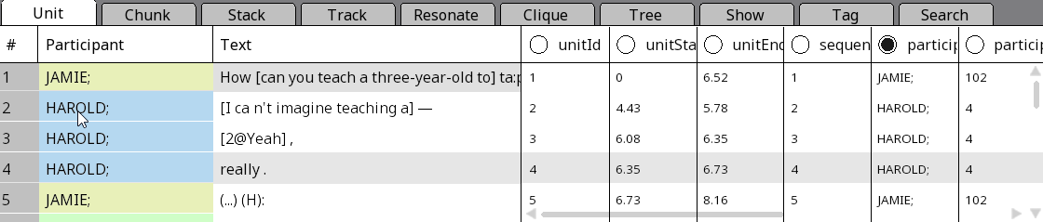



Using one-to-one view to see Unit properties
When does the unit start & end in the audio file (in sec.)?

Slide 39
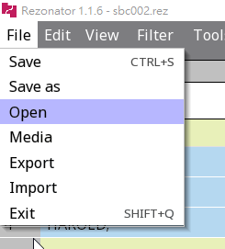
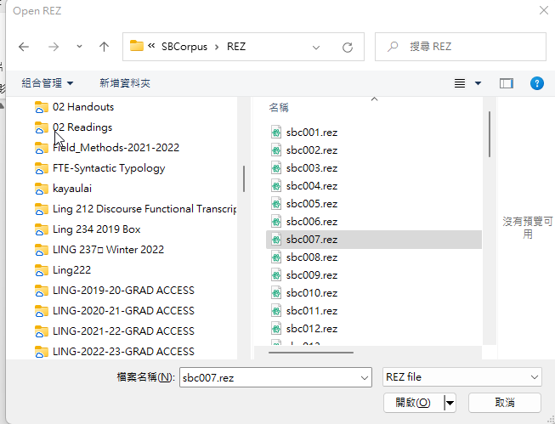
Opening a different transcript
Now we’ll try to open another file – use File > Open
You should have Santa Barbara Corpus files in a path like (something)\Rezonator\Version 1.1.7\Data\SBCorpus\REZ\
Open sbc007.rez

Slide 40

Save before you leave!
Save the file with Ctrl + S or File > Save!

Slide 41
For Wednesday
Settle on a 30min timeslot where your whole group can meet with me
  I can do any time other than class time and Thur 9am
Read one of three readings: Gonzáles Temer (2014), Guo, Zhou & Chow (2012), Shin & Otheguy (2009)
  These are mostly to show what kinds of research we can do with conversational data
  Not the most impressive in terms of visualisations – we’ll discuss ways to improve them visually

