Slide 1



LING 194 Week 6 Preparations (1): Conditional inference trees
Ryan Ka Yau Lai
University of California, Santa Barbara

Slide 2
Can we guess when we use yeah and when we use mhm?
textLower | hierarchy | seqPosition | stanceType | responsiveness | word Order | unitBack | unitTurnOrder | unitTurnBack
yeah | no_clear_hierarchy | other | affirmation | otherElicited | 1 | 1 | 1 | 3
yeah | no_clear_hierarchy | other | understanding | otherNonElicited | 2 | 1 | 2 | 4
mhm | K_plus | second | understanding | otherElicited | 1 | 1 | 1 | 3
mhm | K_minus | third | understanding | otherNonElicited | 1 | 1 | 1 | 4

Slide 3





The idea of predictive modelling

Slide 4


The idea of predictive modelling
Predictors
textLower | hierarchy | seqPosition | stanceType | responsiveness | word Order | unitBack | unitTurnOrder | unitTurnBack
yeah | no_clear_hierarchy | other | affirmation | otherElicited | 1 | 1 | 1 | 3
Response

Slide 5
Classification vs regression problems
Classification problem: You put things into categories (e.g. yeah and mhm)
  Unlike for clustering, the categories are pre-defined
Regression problem: You guess a continuous numerical value (e.g. duration)
We will focus on classification problems: How to guess whether someone will say mhm or yeah?

Slide 6





A basic conditional inference tree

Slide 7

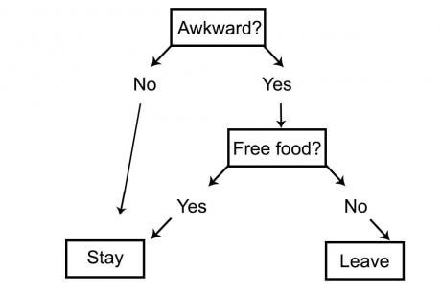



Decision tree
Non-terminal nodes - Variables
Edges - Categories
Terminal nodes - Decisions

Slide 8
Recursive partitioning algorithm
Goal: Sort these into shapes, using only colour.
Other

Slide 9
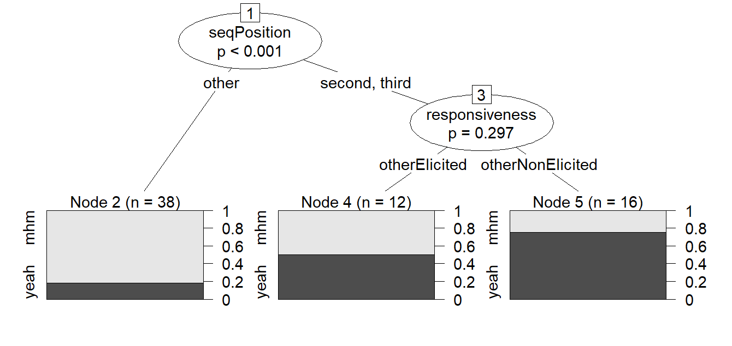
Interpreting the decision tree
If the sequential position is not a second pair part or a post-expansion, then it’s most likely mhm
If it is a second pair part or post-expansion, and was elicited, then it’s half / half chance
If it is a second pair part or post-expansion, and was non-elicited, it’s most likely yeah

Slide 10

Improving the visualisation

Slide 11
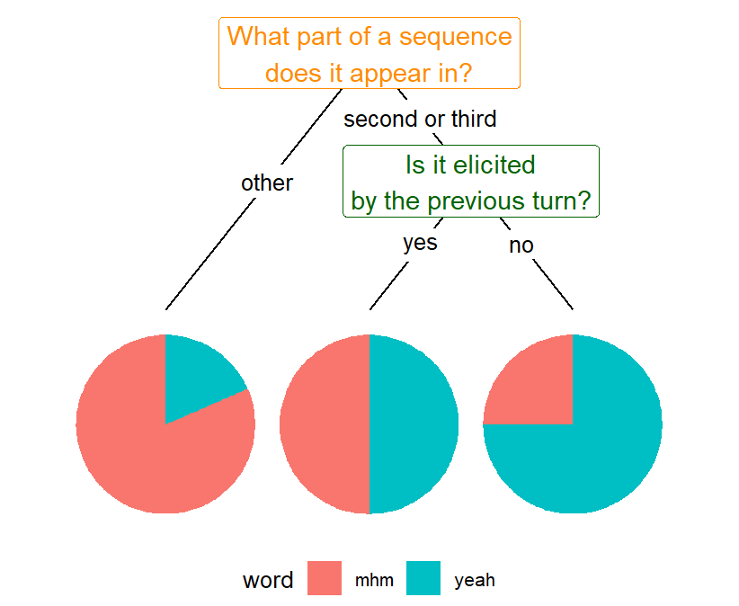
Making the tree easier to understand …

